Slide 1
Bacteria & Viruses

Slide 2
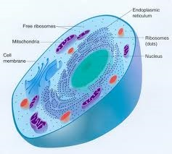
What are the Characteristics of Organisms or Living Things?
All living things are composed of cells
All living things perform certain chemical processes such as growth and digestion
All living things can reproduce
All living things either make their own nutrients or ingest nutrients from the environment
All living things respond to stimuli such as light and touch

Slide 3
What are Bacteria (Prokaryotes)?
Most microbes are prokaryotes (no nucleus, no membrane-bound organelles)
Exist almost every where on earth
Cells that do not have a nucleus
Contains a rigid cell wall, cytoplasm and ribosomes.
Identifying Prokaryotes:
Cell Shape
Cell Wall
Movement

Slide 4
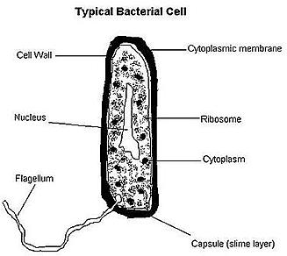
How are Bacteria Structured?
Enclosed by a cell wall
Contains cytoplasm and hereditary material of the cell
Ribsomes are the only organelle found in the cytoplasm

Slide 5
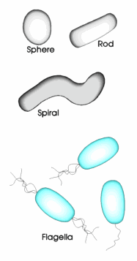
What are the different Bacterium Shapes?
Cocci ~ Sphere shaped bacteria
Bacillus ~ Rod shaped bacteria
Spirrillium ~ Spiral shaped bacteria
Flagella~ Leg-like structures that help to propel the bacterium.

Slide 6
Cellular organism copies it’s genetic information then splits into two identical daughter cells

Slide 7
Conjugation
A type of Bacteria Reproduction
Two organisms swap genetic information, that contains the information such as a resistance to penicillin (an antibiotic)

Slide 8
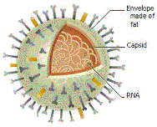
What are Viruses?
A virus is a non-cellular particle made up of genetic material and protein that can invade living cells and reproduce.

Slide 9
What are Viruses?
With the ability to reproduce, viruses lack nearly every characteristic of life
Not composed of cells
Do not respond to stimuli
Do not use energy for growth and development
Need electron microscope to see

Slide 10
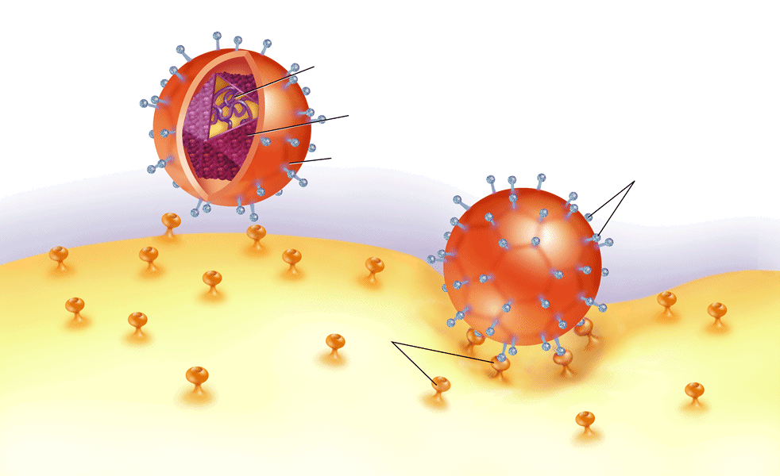
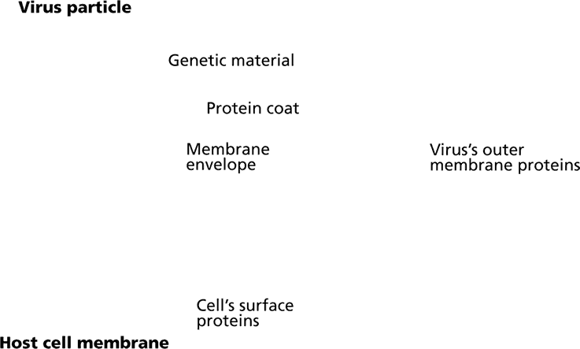
How is a virus structured?
DNA or RNA (retrovirus)
Surrounded by protective protein coat (capsid)
Genetic material carries information for multiplication
Hijacks biochemical machinery of host cell to carry these processes out

Slide 11
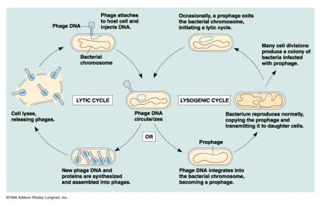
Cycle of Lytic and Lysogenic

Slide 12
What is the definition of Disease?
Any change that disrupts the normal function of one or more body systems.
What are Noninfectious diseases?
Noninfectious diseases: Diseases caused by exposure to certain chemicals or traits that are inherited.
What are infectious diseases?
Infectious diseases: Diseases caused by a pathogen .
What is a pathogen?
any microbe that causes disease.

Slide 13
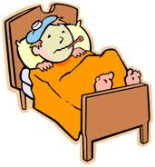
How are Infectious Diseases Spread?
Infectious disease can be spread through:
1. contact with an infected person
ex: Influenza (V)
2. contact with a contaminated object
ex: Athleteis foot (F) or Influenza (V)
3. contact with an infected animal
ex: Lyme Disease (B): Bite from infected tick
contact with an environmental source.

Slide 14
Diseases Caused by Bacteria
How are bacterial infections cured or treated?
Use antibiotics to cure bacterial infections
What are antibiotics?
a chemical that can kill bacteria without harming a person’s cell
What is antibiotic resistance?
Bacteria can develop a resistance to antibiotic and will no longer kill
This is what happens when you do not take medicine completely
What are some examples of diseases caused by bacteria?
Anthrax
Lyme Disease
Leprosy
Bacterial Meningitis
Strep Throat
Tuberculosis

Slide 15
What are some examples of diseases caused by viruses?
Rabies
Influenza
West Nile Virus
Viral Meningitis
Polio
Common Cold
AIDS/HIV
Chicken Pox
Small Pox
Yellow Fever *
Ebola
SARS

Slide 16
How are diseases caused by viruses?
Cause disease by either damaging or killing cells
First attaches itself to a healthy cell and then injects its DNA or RNA into cell
Then replicates once inside infected cell
No Cure, just prevention with vaccine.
What are vaccines?
Vaccines: a substance introduced into the body to stimulate the production of chemicals that destroy specific viruses or bacteria..

Slide 17
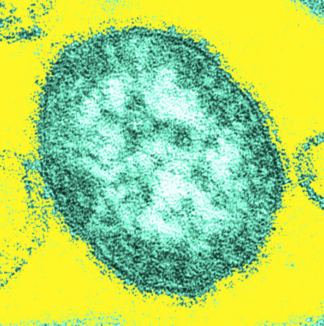
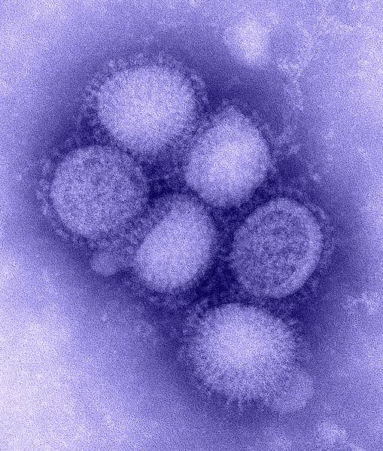
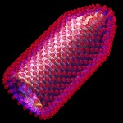
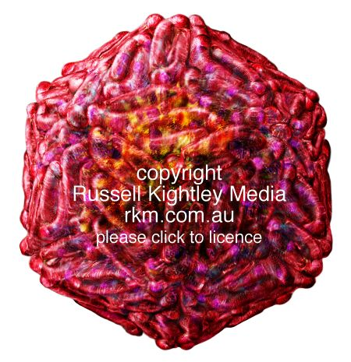
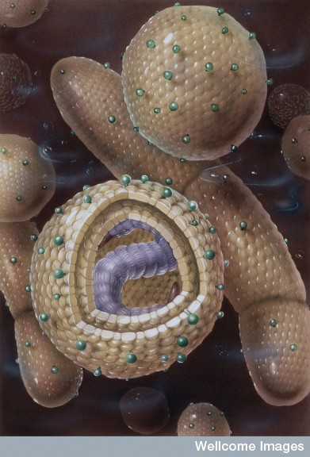
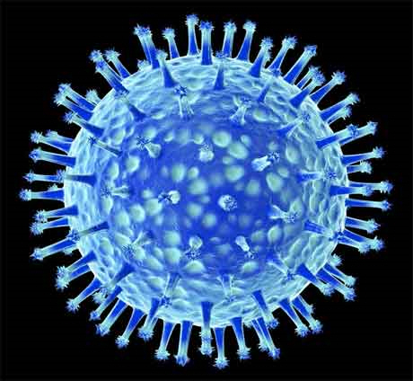
Measles
Rabies
Hepatitis
H1N1: Swine Flu
West Nile Virus
H5N1: Avian Flu

