Slide 1
DNA & RNA Guided Notes

Slide 2
DNA
First, remember that chromosomes are composed mostly of DNA and is found in cells.
DNA is short for deoxyribonucleic acid. It is an acid that contains genetic instructions used in the development and functioning of all known living organisms.
It is known as the blueprints that help your body construct itself.

Slide 3
DNA
It is located inside chromosomes, which are inside of the cells.
A gene is a segment of DNA to code specific traits.
A gene is what codes DNA for a particular heredity trait.

Slide 4
DNA
Is made up of bases, that are marked with a capital letter. The letters in DNA are: A-T-C-G.
A- Adenine
T- Thymine
C- Cytosine
G- Guanine
These are types of sugars.

Slide 5
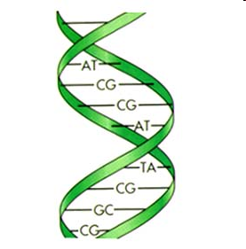
DNA

Slide 6
Order
The order of the nitrogen bases along a gene form a genetic code that specifies what type of protein will be produced.

Slide 7
How cells make proteins
Also called protein synthesis.
During protein synthesis, the cell uses information from a gene on a chromosome to produce a specific protein.

Slide 8
RNA
The genetic messenger that first carries genetic code from the DNA inside the nucleus of a cell into the cytoplasm is called ribonucleic acid, or RNA.

Slide 9
RNA
Similar to DNA, but lets list the differences:
RNA is single stranded and is made up bases marked with letters- C-A-U-G
The T in DNA is substituted for a U in RNA.
This is because Thymine is only found in DNA, while Uracil is only found in RNA.

Slide 10
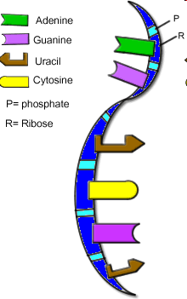
RNA

Slide 11
DNA vs RNA
DNA
  Double stranded
  Thymine present
  Uracil absent
  Thymine- is part of the DNA that is represented by G-C-A-T
RNA
  Single stranded
  Thymine absent
  Uracil present
  Uracil- found only in RNA is a type of nitrogen in genetic code that attaches to a sugar.

Slide 12
2 Roles of RNA
Messenger RNA - copies the coded message from the DNA in the nucleus and carries the message to the ribosome in the cytoplasm.
Transfer RNA- carries amino acids to the ribosome and adds them to the growing proteins.

Slide 13
Protein Synthesis
This is the transfer between DNA and RNA.
The Uracil in the RNA replaces the Thymine in the DNA.

Slide 14
Mutations
Mutations can cause a cell to produce an incorrect protein during protein synthesis. As a result, the organism’s trait, or phenotype, may be different from what it normally would have been.

Slide 15
3 types of mutations in genes:
Substitution- a base pair is substituted for another.
Deletion- one base pair is removed.
Addition (insertion) - one base pair is added.

Slide 16
Effects of Mutations
White lemur - could be harmful due it’s inability to hide in the wild.
Six toes on a cat.
Two-headed cobra

Slide 17
DNA Video clips & Game
https://www.youtube.com/watch?v=zwibgNGe4aY
https://www.youtube.com/watch?v=5MQdXjRPHmQ&feature=youtu.be
http://www.learner.org/interactives/dna/project8.html

