Slide 1
History of DNA

Slide 2
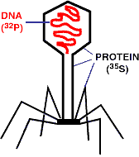
History of DNA
Chromosomes are made of both DNA and protein
Experiments on bacteriophage viruses by Hershey & Chase proved that DNA was the cell’s genetic material
Radioactive ³²P was injected into bacteria!

Slide 3
Discovery of DNA Structure
Erwin Chargaff showed the amounts of the four bases on DNA ( A,T,C,G)
In a body or somatic cell:
A = 30.3%
T = 30.3%
G = 19.5%
C = 19.9%

Slide 4
Chargaff’s Rule
Adenine must pair with Thymine
Guanine must pair with Cytosine
The bases form weak hydrogen bonds
T
A
G
C

Slide 5
DNA Structure
Rosalind Franklin took diffraction x-ray photographs of DNA crystals
In the 1950’s, Watson & Crick built the first model of DNA using Franklin’s x-rays

Slide 6
DNA Structure

Slide 7
DNA
Two strands coiled called a double helix
Sides made of a pentose sugar Deoxyribose bonded to phosphate (PO₄) groups by phosphodiester bonds
Center made of nitrogen bases bonded together by weak hydrogen bonds

Slide 8
DNA Double Helix
“Rungs of ladder”
Nitrogenous
Base (A,T,G or C)
“Legs of ladder”
Phosphate &
Sugar Backbone

Slide 9
DNA
Stands for Deoxyribonucleic acid
Made up of subunits called nucleotides
Nucleotide made of:
1. Phosphate group
2. 5-carbon sugar
3. Nitrogenous base

Slide 10
DNA Nucleotide
Phosphate
Group
O
O=P-O
O
5
CH2
O
N
Nitrogenous base
(A, G, C, or T)
C⁴
C¹
Sugar
(deoxyribose)
C³
C²

Slide 11
Pentose Sugar
Carbons are numbered clockwise 1’ to 5’
5
CH2
O
C⁴
C¹
Sugar
(deoxyribose)
C³
C²

Slide 12
DNA
5
O
3
3
O
P
5
P
5
O
G
C
1
2
3
4
4
2
1
3
5
P
O
P
T
A
3
5
O
O
P
5
P
3

Slide 13
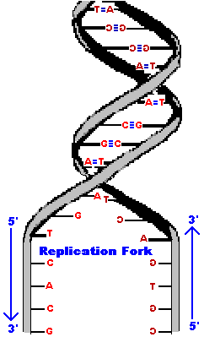
Antiparallel Strands
One strand of DNA goes from 5’ to 3’ (sugars)
The other strand is opposite in direction going 3’ to 5’ (sugars)

Slide 14
Nitrogenous Bases
Double ring PURINES
Adenine (A)
Guanine (G)
Single ring PYRIMIDINES
Thymine (T)
Cytosine (C)
A or G
T or C

Slide 15
Base-Pairings
Purines only pair with Pyrimidines
Three hydrogen bonds required to bond Guanine & Cytosine
3 H-bonds
G
C

Slide 16
Two hydrogen bonds are required to bond Adenine & Thymine
T
A

Slide 17
Question:
If there is 30% Adenine, how much Cytosine is present?

Slide 18
Answer:
There would be 20% Cytosine
Adenine (30%) = Thymine (30%)
Guanine (20%) = Cytosine (20%)
Therefore, 60% A-T and 40% C-G

Slide 19
DNA Replication

Slide 20
Replication Facts
DNA has to be copied before a cell divides
DNA is copied during the S or synthesis phase of interphase
New cells will need identical DNA strands

Slide 21
Synthesis Phase (S phase)
S phase during interphase of the cell cycle
Nucleus of eukaryotes
S
phase
DNA replication takes
place in the S phase.
G₁
G₂
interphase
Mitosis
-prophase
-metaphase
-anaphase
-telophase

Slide 22
DNA Replication
Begins at Origins of Replication
Two strands open forming Replication Forks (Y-shaped region)
New strands grow at the forks
3’
Parental DNA Molecule
5’
Replication
Fork
3’
5’

Slide 23
DNA Replication
As the 2 DNA strands open at the origin, Replication Bubbles form
Prokaryotes (bacteria) have a single bubble
Eukaryotic chromosomes have MANY bubbles
Bubbles
Bubbles

Slide 24
DNA Replication
Enzyme Helicase unwinds and separates the 2 DNA strands by breaking the weak hydrogen bonds
Single-Strand Binding Proteins attach and keep the 2 DNA strands separated and untwisted

Slide 25
DNA Replication
Enzyme Topoisomerase attaches to the 2 forks of the bubble to relieve stress on the DNA molecule as it separates
Enzyme
Enzyme
DNA

Slide 26
DNA Replication
Before new DNA strands can form, there must be RNA primers present to start the addition of new nucleotides
Primase is the enzyme that synthesizes the RNA Primer
DNA polymerase can then add the new nucleotides

Slide 27
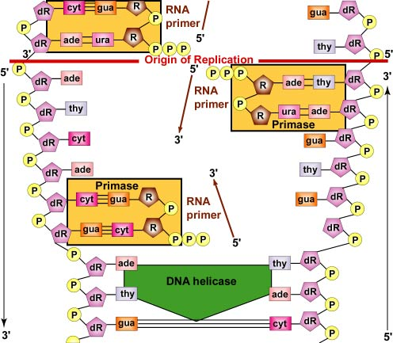

Slide 28
DNA Replication
DNA polymerase can only add nucleotides to the 3’ end of the DNA
This causes the NEW strand to be built in a 5’ to 3’ direction
5’
3’
5’
RNA
Primer
DNA Polymerase
Nucleotide
Direction of Replication

Slide 29
Remember HOW the Carbons Are Numbered!
Phosphate
Group
O
O=P-O
O
5
CH2
O
N
Nitrogenous base
(A, G, C, or T)
C⁴
C¹
Sugar
(deoxyribose)
C³
C²

Slide 30
Remember the Strands are Antiparallel
5
O
3
3
O
P
5
P
5
O
G
C
1
2
3
4
4
2
1
3
5
P
O
P
T
A
3
5
O
O
5
P
P
3

Slide 31
Synthesis of the New DNA Strands
The Leading Strand is synthesized as a single strand from the point of origin toward the opening replication fork
5’
3’
5’
RNA
Primer
Nucleotides
DNA Polymerase

Slide 32
Synthesis of the New DNA Strands
The Lagging Strand is synthesized discontinuously against overall direction of replication
This strand is made in MANY short segments It is replicated from the replication fork toward the origin
5’
Leading Strand
3’
3’
5’
DNA Polymerase
RNA Primer
5’
3’
3’
5’
Lagging Strand

Slide 33
Lagging Strand Segments
Okazaki Fragments - series of short segments on the lagging strand
Must be joined together by an enzyme
DNA
Polymerase
Okazaki Fragment
RNA
Primer
5’
3’
3’
5’
Lagging Strand

Slide 34
Joining of Okazaki Fragments
The enzyme Ligase joins the Okazaki fragments together to make one strand
DNA ligase
5’
Okazaki Fragment 1
Okazaki Fragment 2
3’
3’
5’
Lagging Strand

Slide 35
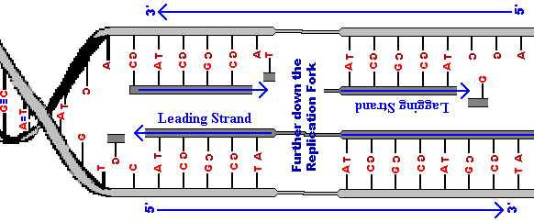
Replication of Strands
Replication Fork
Point of Origin

Slide 36
Proofreading New DNA
DNA polymerase initially makes about 1 in 10,000 base pairing errors
Enzymes proofread and correct these mistakes
The new error rate for DNA that has been proofread is 1 in 1 billion base pairing errors

Slide 37
Semiconservative Model of Replication
Idea presented by Watson & Crick
The two strands of the parental molecule separate, and each acts as a template for a new complementary strand
New DNA consists of 1 PARENTAL (original) and 1 NEW strand of DNA
DNA Template
Parental DNA
New DNA

Slide 38
DNA Damage & Repair
Chemicals & ultraviolet radiation damage the DNA in our body cells
Cells must continuously repair DAMAGED DNA
Excision repair occurs when any of over 50 repair enzymes remove damaged parts of DNA
DNA polymerase and DNA ligase replace and bond the new nucleotides together

Slide 39
Question:
What would be the complementary DNA strand for the following DNA sequence?
DNA 5’-CGTATG-3’

Slide 40
Answer:
DNA 5’-CGTATG-3’
DNA 3’-GCATAC-5’

