Slide 1
MEIOSIS

Slide 2
Organisms that reproduce Sexually are made up of two different types of cells.
Somatic Cells are “body” cells and contain the normal number of chromosomes ….called the “Diploid” number (the symbol is 2n). Examples would be … skin cells, brain cells, etc.
Gametes are the “sex” cells and contain only ½ the normal number of chromosomes…. called the “Haploid” number (the symbol is n)….. Sperm cells and ova are gametes.
n = number of chromosomes in the set… so….2n means 2 chromosomes in the set…. Polyploid cells have more than two chromosomes per set… example: 3n (3 chromosomes per set)

Slide 3
Gametes
The Male Gamete is the Sperm and is produced in the male gonad the Testes.
The Female Gamete is the Ovum (ova = pl.) and is produced in the female gonad the Ovaries.

Slide 4
During Ovulation the ovum is released from the ovary and transported to an area where fertilization, the joining of the sperm and ovum, can occur…… fertilization, in Humans, occurs in the Fallopian tube. Fertilization results in the formation of the Zygote. (fertilized egg)
fertilization
Sperm + Ovum (egg) Zygote

Slide 5
Fertilization
The fusion of a sperm and egg to form a zygote.
A zygote is a fertilized egg
sperm
n=23
n=23
egg
2n=46
zygote

Slide 6
Chromosomes
If an organism has the Diploid number (2n) it has two matching homologues per set. One of the homologues comes from the mother (and has the mother’s DNA).… the other homologue comes from the father (and has the father’s DNA).
Most organisms are diploid. Humans have 23 sets of chromosomes… therefore humans have 46 total chromosomes….. The diploid number for humans is 46 (46 chromosomes per cell).

Slide 7
Homologous Chromosomes
Pair of chromosomes (maternal and paternal) that are similar in shape and size.
Homologous pairs (tetrads) carry genes controlling the same inherited traits.
Each locus (position of a gene) is in the same position on homologues.
Humans have 23 pairs of homologous chromosomes.
22 pairs of autosomes
1 pair of sex chromosomes

Slide 8
Homologous Chromosomes (because a homologous pair consists of 4 chromatids it is called a “Tetrad”)
eye color
locus
eye color
locus
hair color
locus
hair color
locus
Paternal
Maternal

Slide 9
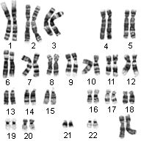
Humans have 23 Sets of Homologous Chromosomes Each Homologous set is made up of 2 Homologues.
Homologue
Homologue

Slide 10
Autosomes (The Autosomes code for most of the offspring’s traits)
In Humans the “Autosomes” are sets 1 - 22

Slide 11
Sex Chromosomes The Sex Chromosomes code for the sex of the offspring. ** If the offspring has two “X” chromosomes it will be a female. ** If the offspring has one “X” chromosome and one “Y” chromosome it will be a male.
In Humans the “Sex Chromosomes” are the 23rd set
XX chromosome - female
XY chromosome - male

Slide 12
Sex Chromosomes
“Sex Chromosomes” …….the 23rd set
This person has 2 “X” chromosomes… and is a female.
23

Slide 13
Meiosis is the process by which ”gametes” (sex cells) , with half the number of chromosomes, are produced.
During Meiosis diploid cells are reduced to haploid cells
Diploid (2n) → Haploid (n)
If Meiosis did not occur the chromosome number in each new generation would double…. The offspring would die.

Slide 14
Meiosis
Meiosis is Two cell divisions
(called meiosis I and meiosis II)
with only one duplication of chromosomes.

Slide 15
Meiosis in males is called spermatogenesis and produces sperm.
Meiosis in females is called oogenesis and produces ova.

Slide 16
Spermatogenesis
n=23
Secondary Spermatocyte
human
sex cell
sperm
Primary Spermatocyte
n=23
n=23
2n=46
Secondary Spermatocyte
haploid (n)
n=23
n=23
diploid (2n)
4 sperm cells are produced from each primary spermatocyte.
n=23
meiosis I
meiosis II

Slide 17
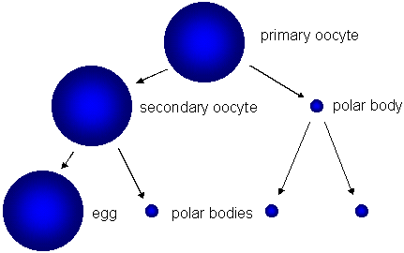
Oogenesis
*** The polar bodies die… only one ovum (egg) is produced from each primary oocyte.

Slide 18
Interphase I
Similar to mitosis interphase.
Chromosomes replicate (S phase).
Each duplicated chromosome consist of two identical sister chromatids attached at their centromeres.
Centriole pairs also replicate.

Slide 19
Interphase I
Nucleus and nucleolus visible.
chromatin
nuclear membrane
cell membrane
nucleolus

Slide 20
Meiosis I (four phases)
Cell division that reduces the chromosome number by one-half.
four phases:
a. prophase I
b. metaphase I
c. anaphase I
d. telophase I

Slide 21
Prophase I
Longest and most complex phase.
90% of the meiotic process is spent in Prophase I
Chromosomes condense.
Synapsis occurs: homologous chromosomes come together to form a tetrad.
Tetrad is two chromosomes or four chromatids (sister and nonsister chromatids).

Slide 22
Prophase I - Synapsis
Homologous chromosomes
sister chromatids
sister chromatids
Tetrad

Slide 23
During Prophase I “Crossing Over” occurs.
Crossing Over is one of the Two major occurrences of Meiosis
(The other is Non-disjunction)
During Crossing over segments of nonsister chromatids break and reattach to the other chromatid. The Chiasmata (chiasma) are the sites of crossing over.

Slide 24
Crossing Over creates variation (diversity) in the offspring’s traits.
nonsister chromatids
Tetrad
chiasmata: site of crossing over
variation

Slide 25
Question:
A cell containing 20 chromosomes (diploid) at the beginning of meiosis would, at its completion, produce cells containing how many chromosomes?

Slide 26
Answer:
10 chromosomes (haploid)

Slide 27
Question:
A cell containing 40 chromatids at the beginning of meiosis would, at its completion, produce cells containing how many chromosomes?

Slide 28
Answer:
10 chromosomes

Slide 29
Prophase I
spindle fiber
centrioles
aster
fibers

Slide 30
Metaphase I
Shortest phase
Tetrads align on the metaphase plate.
INDEPENDENT ASSORTMENT OCCURS:
1. Orientation of homologous pair to poles is random.
2. Variation
3. Formula: 2^{n}
Example: 2n = 4
then n = 2
thus 2² = 4 combinations

Slide 31
Metaphase I
OR
metaphase plate
metaphase plate

Slide 32
Anaphase I
Homologous chromosomes separate and move towards the poles.
Sister chromatids remain attached at their centromeres.

Slide 33
Anaphase I

Slide 34
Telophase I
Each pole now has haploid set of chromosomes.
Cytokinesis occurs and two haploid daughter cells are formed.

Slide 35
Telophase I

Slide 36
Meiosis II
No interphase II
(or very short - no more DNA replication)
Remember: Meiosis II is similar to mitosis

Slide 37
Prophase II
same as prophase in mitosis

Slide 38
Metaphase II
same as metaphase in mitosis
metaphase plate
metaphase plate

Slide 39
Anaphase II
same as anaphase in mitosis
sister chromatids separate

Slide 40
Telophase II
Same as telophase in mitosis.
Nuclei form.
Cytokinesis occurs.
Remember: four haploid daughter cells produced.
gametes = sperm or egg

Slide 41
Telophase II

Slide 42
Non-disjunction
Non-disjunction is one of the Two major occurrences of Meiosis
(The other is Crossing Over)
Non-disjunction is the failure of homologous chromosomes, or sister chromatids, to separate during meiosis.
Non-disjunction results with the production of zygotes with abnormal chromosome numbers…… remember…. An abnormal chromosome number (abnormal amount of DNA) is damaging to the offspring.

Slide 43
Non-disjunctions usually occur in one of two fashions.
The first is called Monosomy, the second is called Trisomy. If an organism has Trisomy 18 it has three chromosomes in the 18th set, Trisomy 21…. Three chromosomes in the 21st set. If an organism has Monosomy 23 it has only one chromosome in the 23rd set.

Slide 44
Common Non-disjunction Disorders
Down’s Syndrome – Trisomy 21
Turner’s Syndrome – Monosomy 23 (X)
Kleinfelter’s Syndrome – Trisomy 23 (XXY)
Edward’s Syndrome – Trisomy 18

Slide 45
Amniocentesis
An Amniocentesis is a prrocedure a pregnant woman can have in order to detect some genetics disorders…..such as non-disjunction.

Slide 46
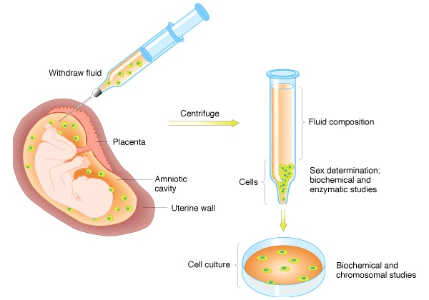
Amniocentesis
Amniotic fluid withdrawn

Slide 47
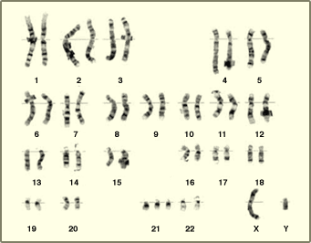
Karyotype (picture of an individual’s chromosomes)
One of the ways to analyze the amniocentesis is to make a Karyotype
What genetic disorder does this karyotype show?
Trisomy 21….Down’s Syndrome

