Slide 1
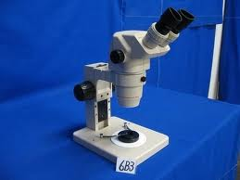
Scientific Tools
Microscope

Slide 2
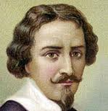
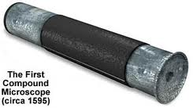
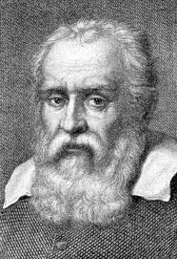
Birth of the Microscope
1590
Zaccharias Janssen and his son Hans experimented with several lenses in a tube and discovered that nearby objects appeared greatly enlarged.
This became the forerunner of the compound microscope and the telescope.
1609
In 1609, Galileo, father of modern physics and astronomy, heard of these early experiments, worked on the principles of lenses, and made IMPROVEMENTS.

Slide 3
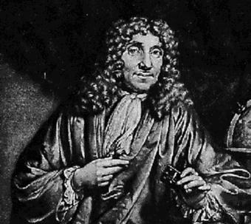
Anton Van Leeuwenhoek, 1632-1723
Father of microscopy
Worked in a dry goods store counting threads using a magnifying glass
Learned how to grind lenses and improve their curvature, magnifying up to 270 diameters
First to look and see organisms in a microscope and give descriptions (called animalcules)
Looked at bacteria, yeast, and pond water

Slide 4
Leeuwenhoek's microscope design:
A) a screw for adjusting the height of the object being examined
B) a metal plate serving as the body
C) a skewer to impale the object and rotate it
D) the lens itself, which was spherical

Slide 5
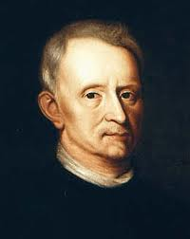
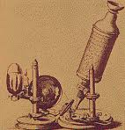
Robert Hooke (1635-1703)
Robert Hooke, considered the English father of microscopy, re-confirmed Leeuwenhoek's discoveries of the existence of tiny living organisms in a drop of water.
Gave the name “cells”
Hooke made a copy of Leeuwenhoek's light microscope and then improved upon his design.

Slide 6
Time Line (Latest Improvements to Earliest Improvements)
Robert Hooke – Improved on Leeuwenhoek’s design
Leeuwenhoek – Father of Microscopy
Galileo - worked on the principles of lenses
Jannesen – worked on glasses

Slide 7
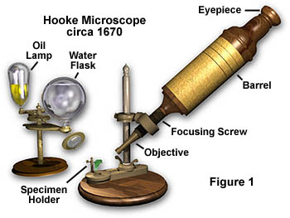

Slide 8
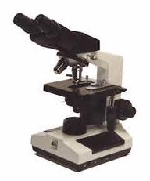
Compound Microscope
Compound microscopes uses electric light or mirror
The image seen is two dimensional.
This microscope is the most commonly used. You can see individual cells, even living ones.
It has high magnification.
However, it has a low resolution.
Cost - $150 - $6000

Slide 9
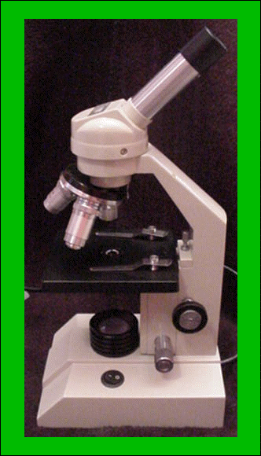
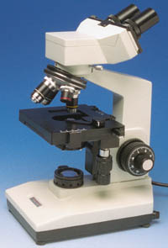
Compound Light Microscope

Slide 10
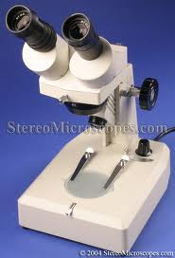
Dissection Microscope
A dissection microscope is light illuminated.
The image that appears is three dimensional.
It is used for dissection to get a better look at the larger specimen.
You cannot see individual cells because it has a low magnification.
Cost - $100 - $1500

Slide 11
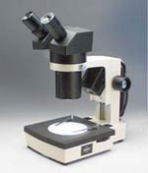
Dissecting Microscope

Slide 12
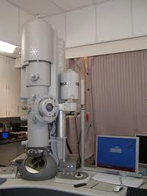
Transmission Electron Microscope
The Transmission Electron Microscope, or TEM, was the first type or Electron Microscope to be produced.
The TEM is modeled exactly on the Light Transmission Microscope except a focused beam of electrons are used to ‘see through’ the specimen.
The first Transmission Electron Microscope was developed by Max Knoll and Ernst Ruska in Germany, in the year 1931.

Slide 13
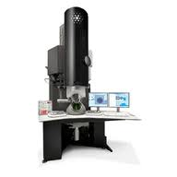
Transmission Electron Microscope
TEM is electron lighted. This gives a 2-D view.
Thin slices of specimen are obtained. The electron beams pass through this.
It has high magnification and high resolution.
Cost - $50,000 - $100,000

Slide 14
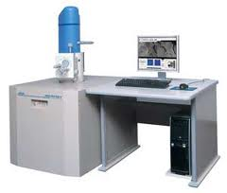
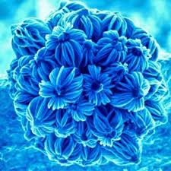
Scanning Electron Microscope
SEM uses electron lighting. The image is seen in 3-D.
It has high magnification and high resolution.
Cost - $50,000 - $100,000
The first Scanning Electron Microscope (SEM) debuted in 1942.

Slide 15
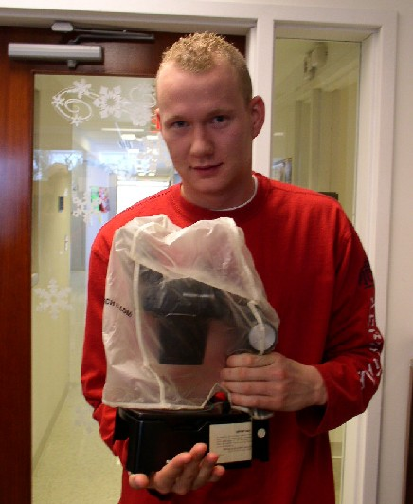
Microscope Care
Always carry with 2 hands
Do not force knobs
Always store covered
Keep objects clear of desk and cords

Slide 16
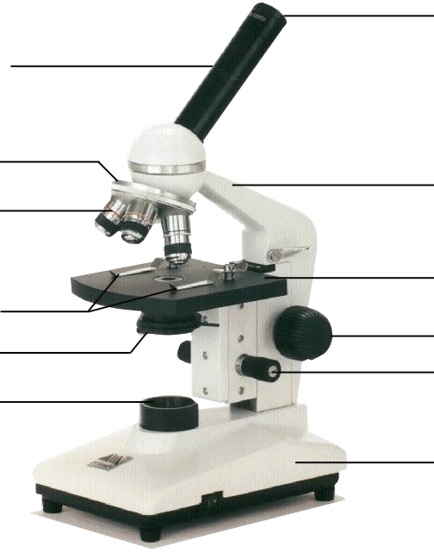
Microscope Parts – Label Now
Eyepiece
Body Tube
Nosepiece
Arm
Objective Lens – 4x
Objective Lens – 10x
Stage
Stage Clips
Coarse Focus
Iris Diaphragm
Fine Focus
Objective Lens – 40x
Light
Base
Notes:
This is the exact version of the microscope used in class. Students will be identifying the parts on the microscopes at their desks as we go along and what their functions are.

Slide 17
Microscope Part Functions
Body tube - maintains the proper distance between the eyepiece and the objectives.
Nosepiece - holds the objectives and can be rotated to change the magnification of the microscope.
Objective Lens - Provides a magnification of 4X and is the shortest objective.
Objective Lens - Provides a magnification of 10X.
Objective Lens - Provides a magnification of 40X and is the longest objective.
Stage Clips - Holds microscope slides in place.
Iris Diaphragm - Regulates the light passing up towards the eyepiece.
Light Source - Sometimes called the illuminator produces/ reflects light up toward the eyepiece.
Ocular Lens (Eyepiece) - Contains a 10X magnifying lens for seeing objects.

Slide 18
Microscope Part Functions
Arm - Supports the body tube; correct location for holding microscope.
Stage - Supports the microscope slide being observed.
Coarse Adjustment Knob - Moves body tube/stage up and down to focus image (low objective ONLY!!!)
Fine Adjustment Knob - Moves body tube/ stage slightly to sharpen image (medium or high objective)
Base - Supports the microscope.

Slide 19
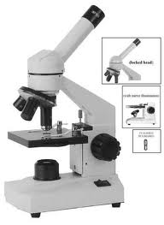
Using the Microscope
Place the Slide on the Microscope
Use Stage Clips
Click Nosepiece to the lowest (shortest) setting
Look into the Eyepiece
Use the Coarse Focus
Notes:
Give students a slide from the “common things” set, each student will practice focusing and changing objectives.

Slide 20
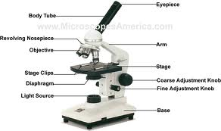
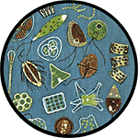
Using High Power
Follow steps to focus using low power
Click the nosepiece to the longest objective
Do NOT use the Coarse Focusing Knob
Use the Fine Focus Knob to bring the slide
What can you find on your slide?
Notes:
Have students exchange slides so they can look at different things, walk them through using the high power objective to focus slides. Emphasize not using the coarse objective during this process, as it will crack the slides.

Slide 21
What’s my power?
To calculate the power of magnification, multiply the power of the ocular lens by the power of the objective.
Total magnification = eyepiece x objective
What are the powers of magnification for each of the objectives we have on our microscopes?
Fill in the answer on your lecture guide.

Slide 22
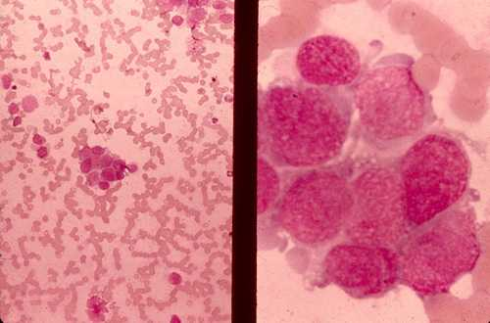
Comparing Powers of Magnification
We can see better details with higher the powers of magnification, but we cannot see as much of the image.
Which of these images would be viewed at a higher power of magnification?

Slide 23
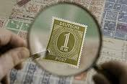
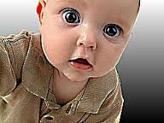
Magnification versus Resolution
Magnification is the process of enlarging an object in its appearance, and NOT in its physical size.
Resolution is the sharpness or amount of detail in an image.

Slide 24
Let’s give it a try ...
1 – Turn on the microscope and then rotate the nosepiece to click the red-banded objective into place.
2 – Place a slide on the stage and secure it using the stage clips. Use the coarse adjustment knob (large knob) to get it the image into view and then use the fine adjustment knob (small knob) to make it clearer.
3 – Once you have the image in view, rotate the nosepiece to view it under different powers. Draw what you see on your worksheet!
Be careful with the largest objective! Sometimes there is not enough room and you will not be able to use it!
4 – When you are done, turn off the microscope and put up the slides you used.

