Slide 1
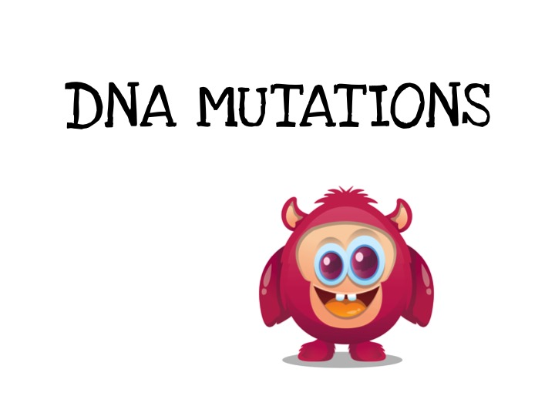
© Vanessa Jason, Biology Roots

Slide 2
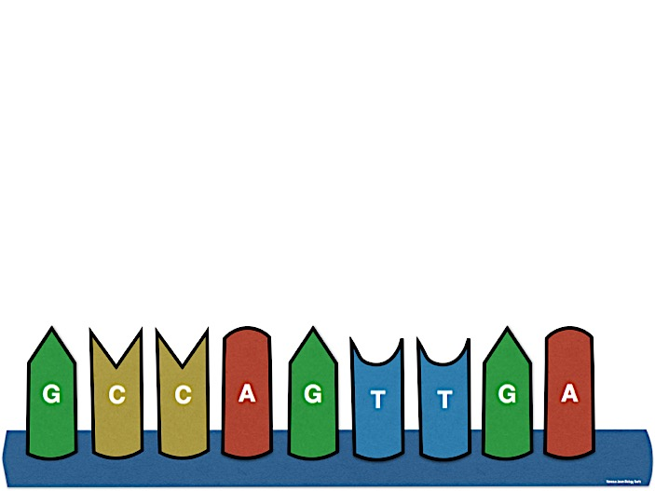
What is a mutation?
© Vanessa Jason, Biology Roots
The word mutation comes from the Latin word “mutare” meaning to change.
The change occurs in the DNA sequences that affect genetic information.

Slide 3
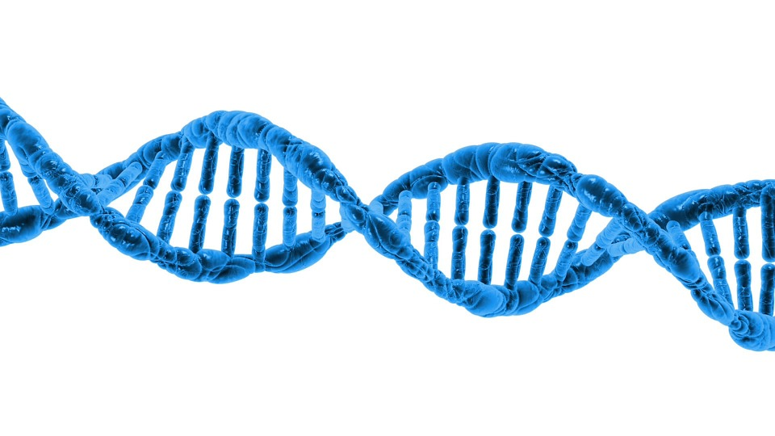
What is a mutation?
© Vanessa Jason, Biology Roots
Mutations occur when the cell makes a mistake in copying its own DNA.
This could be…
Inserting an incorrect nucleotide base
Skipping a nucleotide base entirely
Deleting a nucleotide base
Adding an extra nucleotide base

Slide 4
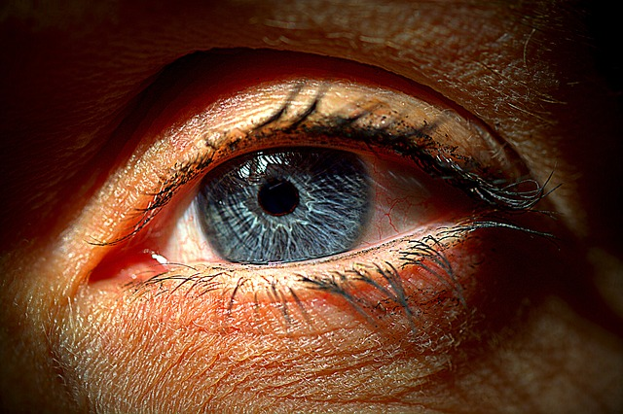
What is a mutation?
© Vanessa Jason, Biology Roots
© Vanessa Jason, Biology Roots
Mutations are not necessarily a bad thing. Most of the time they are neutral- meaning the mutation has no positive or negative effect on the individual.
Example- blue eyes are thought to be the result of a mutated gene for brown eyes.

Slide 5
What Causes Mutations to Occur?
© Vanessa Jason, Biology Roots
Though mutations can occur at random- DNA can be influenced to change under the following conditions:
-UV radiation (example- high sun exposure can mutate the genes that regulate cell division and lead to skin cancer).
-Chemicals
-Viruses (viruses replicate using our DNA replication mechanisms and can sometimes change things to cause mutations).
-Environmental factors

Slide 6
Two General Types of Mutations
© Vanessa Jason, Biology Roots
Mutations can be gene mutations (small scale mutations) or chromosomal mutations (large scale mutations).
-Gene mutations affect a single gene.
-Chromosomal mutations affect many genes on the chromosomes.

Slide 7
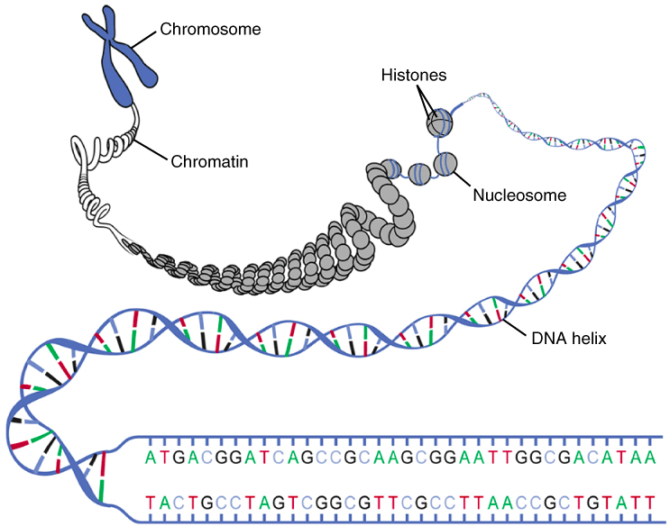
© Vanessa Jason, Biology Roots
Chromosomal mutations occur on a large scale and include a large segment of DNA (many genes).
Gene mutations occur on a small scale within the nucleotide bases
© Vanessa Jason, Biology Roots

Slide 8
Gene Mutations
© Vanessa Jason, Biology Roots
Types of gene mutations:
Point mutation- mutations that affect one nucleotide (one single point in the DNA sequence).
Frameshift mutation- a mutation that affects more than one nucleotide- causes a disturbance or shift in the entire DNA sequence.
© Vanessa Jason, Biology Roots

Slide 9
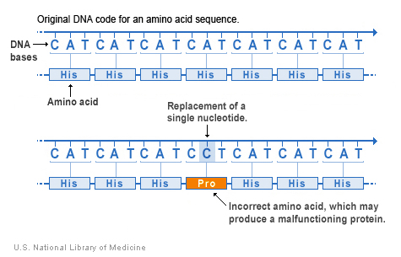
What exactly do mutations DO?
© Vanessa Jason, Biology Roots
Mutations can cause a change in the amino acid, and possibly cause the cell to make a different protein than it was supposed to.
© Vanessa Jason, Biology Roots

Slide 10
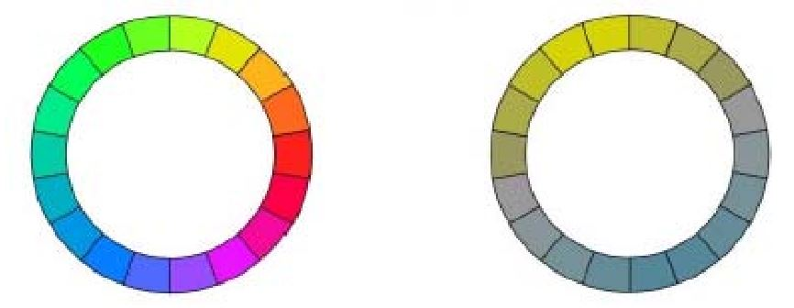
What exactly do mutations DO?
© Vanessa Jason, Biology Roots
Though some mutations can cause life threatening conditions, mutations also create genetic diversity- which is required for survival of a species.
Mutations among species could be the reason they survive certain conditions, or even just a nice bonus!
Example- humans have “trichromatic” vision- which means we can see more colors. This the result of a duplication mutation.
Trichromatic
Dichromatic
© Vanessa Jason, Biology Roots

Slide 11
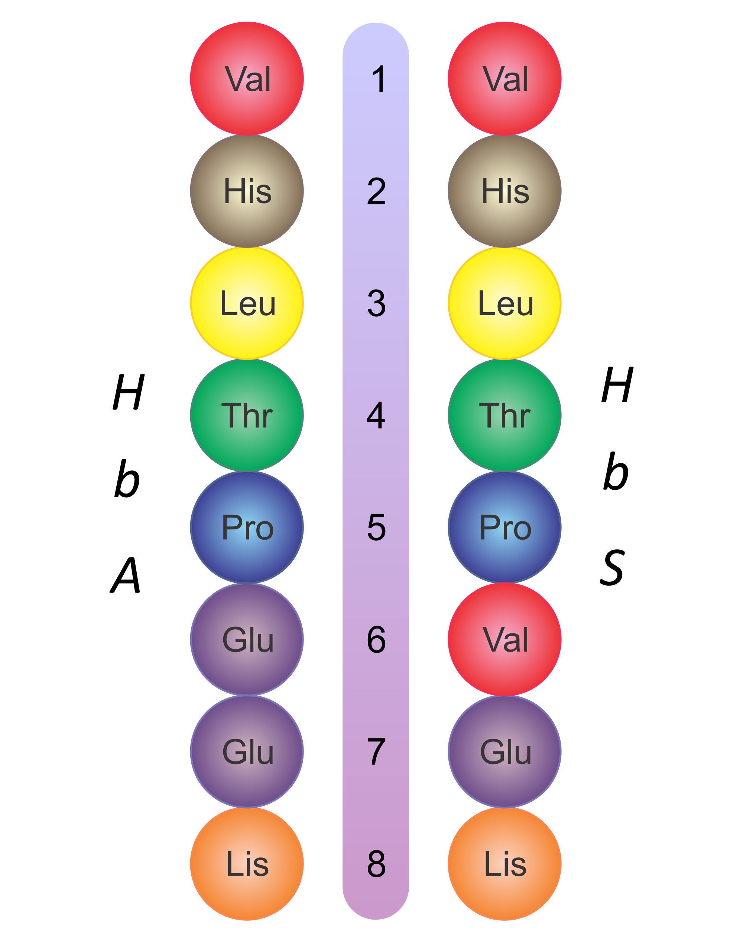
Example of negative mutation-
© Vanessa Jason, Biology Roots
The amino acid sequence on the left creates a normal functioning hemoglobin protein.
The amino acids on the right are the result of a point mutation- amino acid #6 is different.
To make hemoglobin, you need glutamic acid (Glu) as the 6th amino acid.
The faulty protein on the right causes sickle cell anemia.
© Vanessa Jason, Biology Roots

Slide 12
© Vanessa Jason, Biology Roots
© Vanessa Jason, Biology Roots

Slide 13
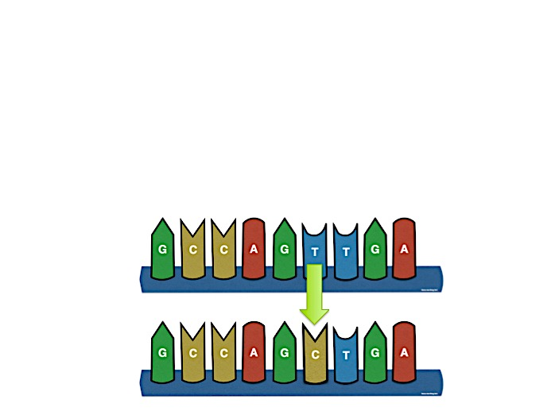
Point Mutations
© Vanessa Jason, Biology Roots
Sometimes, a mutation may have no effect at all. This might occur if the “wrong” nucleotide inserted still translates for the same protein that the original DNA strand codes for.
© Vanessa Jason, Biology Roots

Slide 14
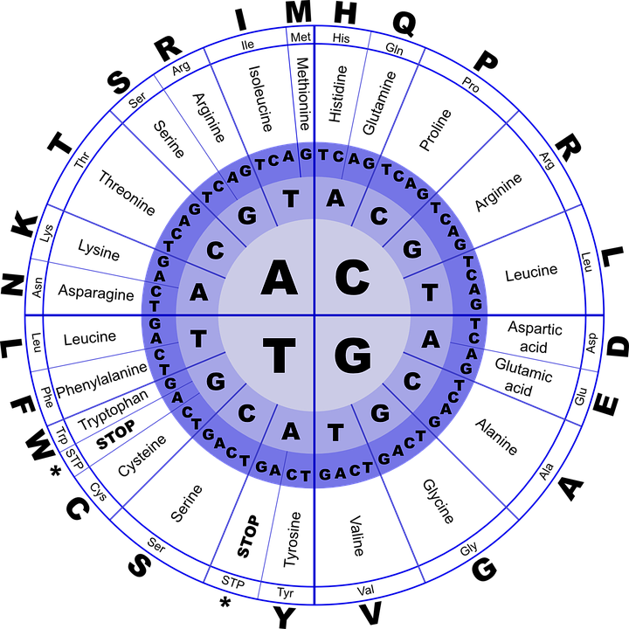
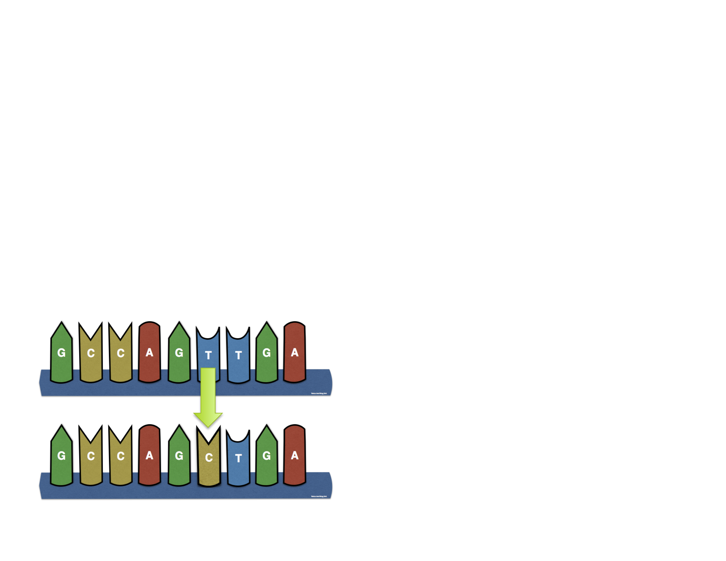
How would this mutation change the protein?
© Vanessa Jason, Biology Roots
A mutations that has no effect on the outcome is known as a silent mutation.
Mutations don’t always have an effect on the protein.
© Vanessa Jason, Biology Roots

Slide 15

Missense vs. Nonsense Mutations
© Vanessa Jason, Biology Roots
Both point mutations and frameshift mutations can fall into the category of missense or nonsense.
Missense mutation= A substitution or deletion that causes the amino acid sequence to change and make a different protein.
Nonsense mutation=A missense mutation that causes the sequence to stop prematurely (a stop codon is accidentally created).
© Vanessa Jason, Biology Roots

Slide 16
Substitution Mutations
© Vanessa Jason, Biology Roots
This example is a substitution- when one nucleotide base is swapped for another- and can sometimes change the amino acid sequence of the protein.
This is a point mutation because this change does not affect any of the other nucleotide bases.
© Vanessa Jason, Biology Roots

Slide 17
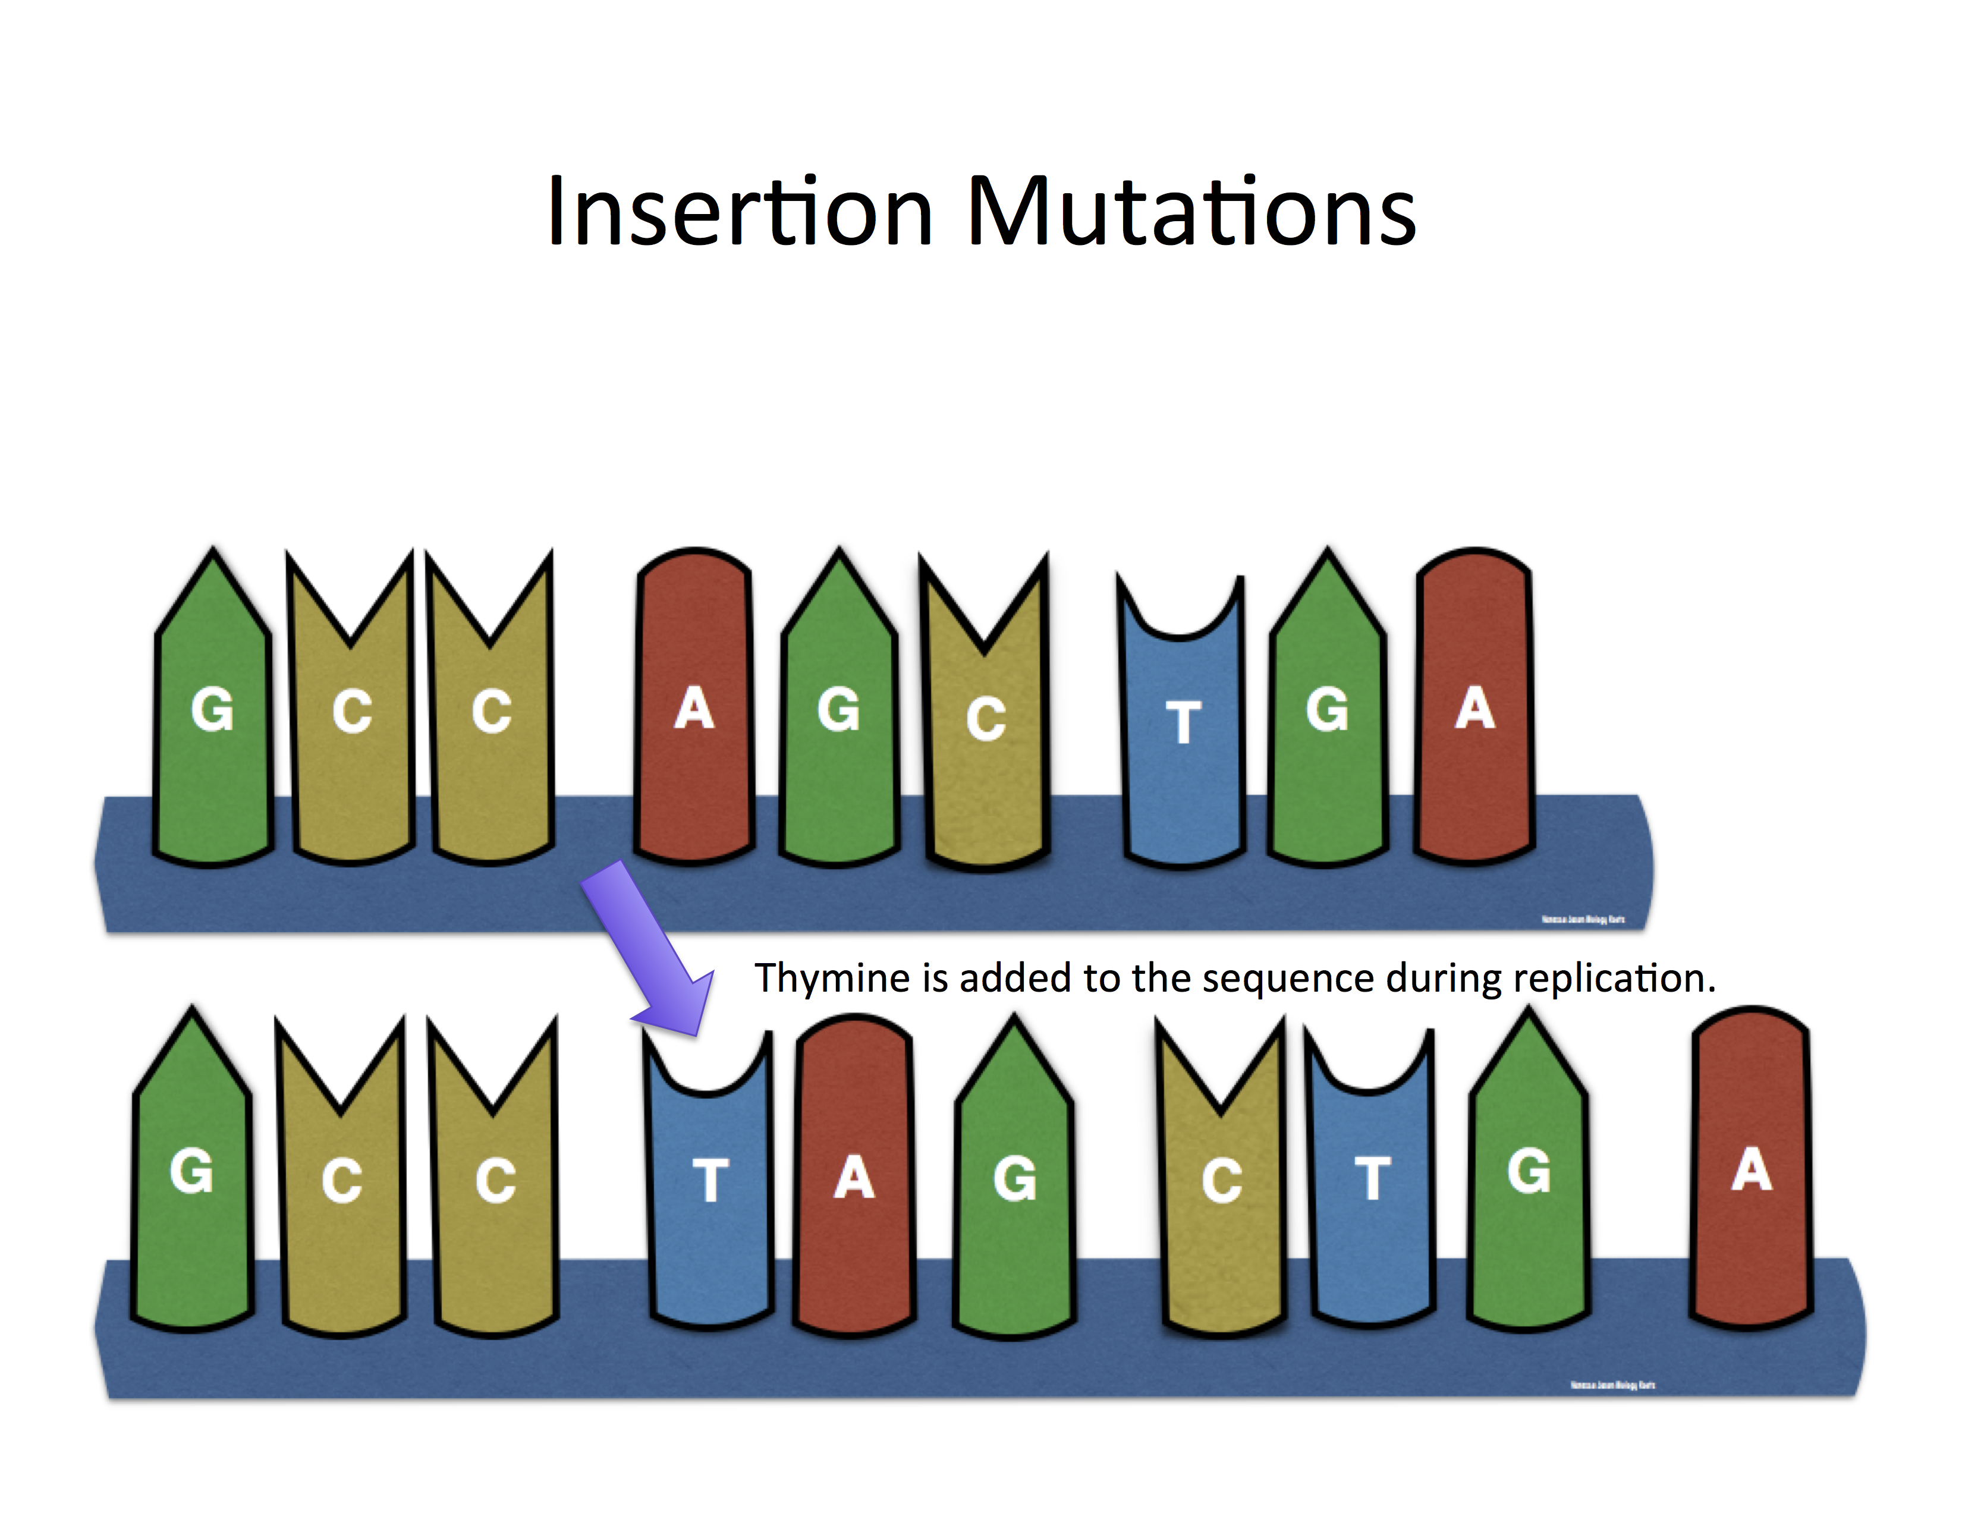
© Vanessa Jason, Biology Roots
Insertion occurs when an extra nucleotide is accidentally added to a sequence.
© Vanessa Jason, Biology Roots

Slide 18
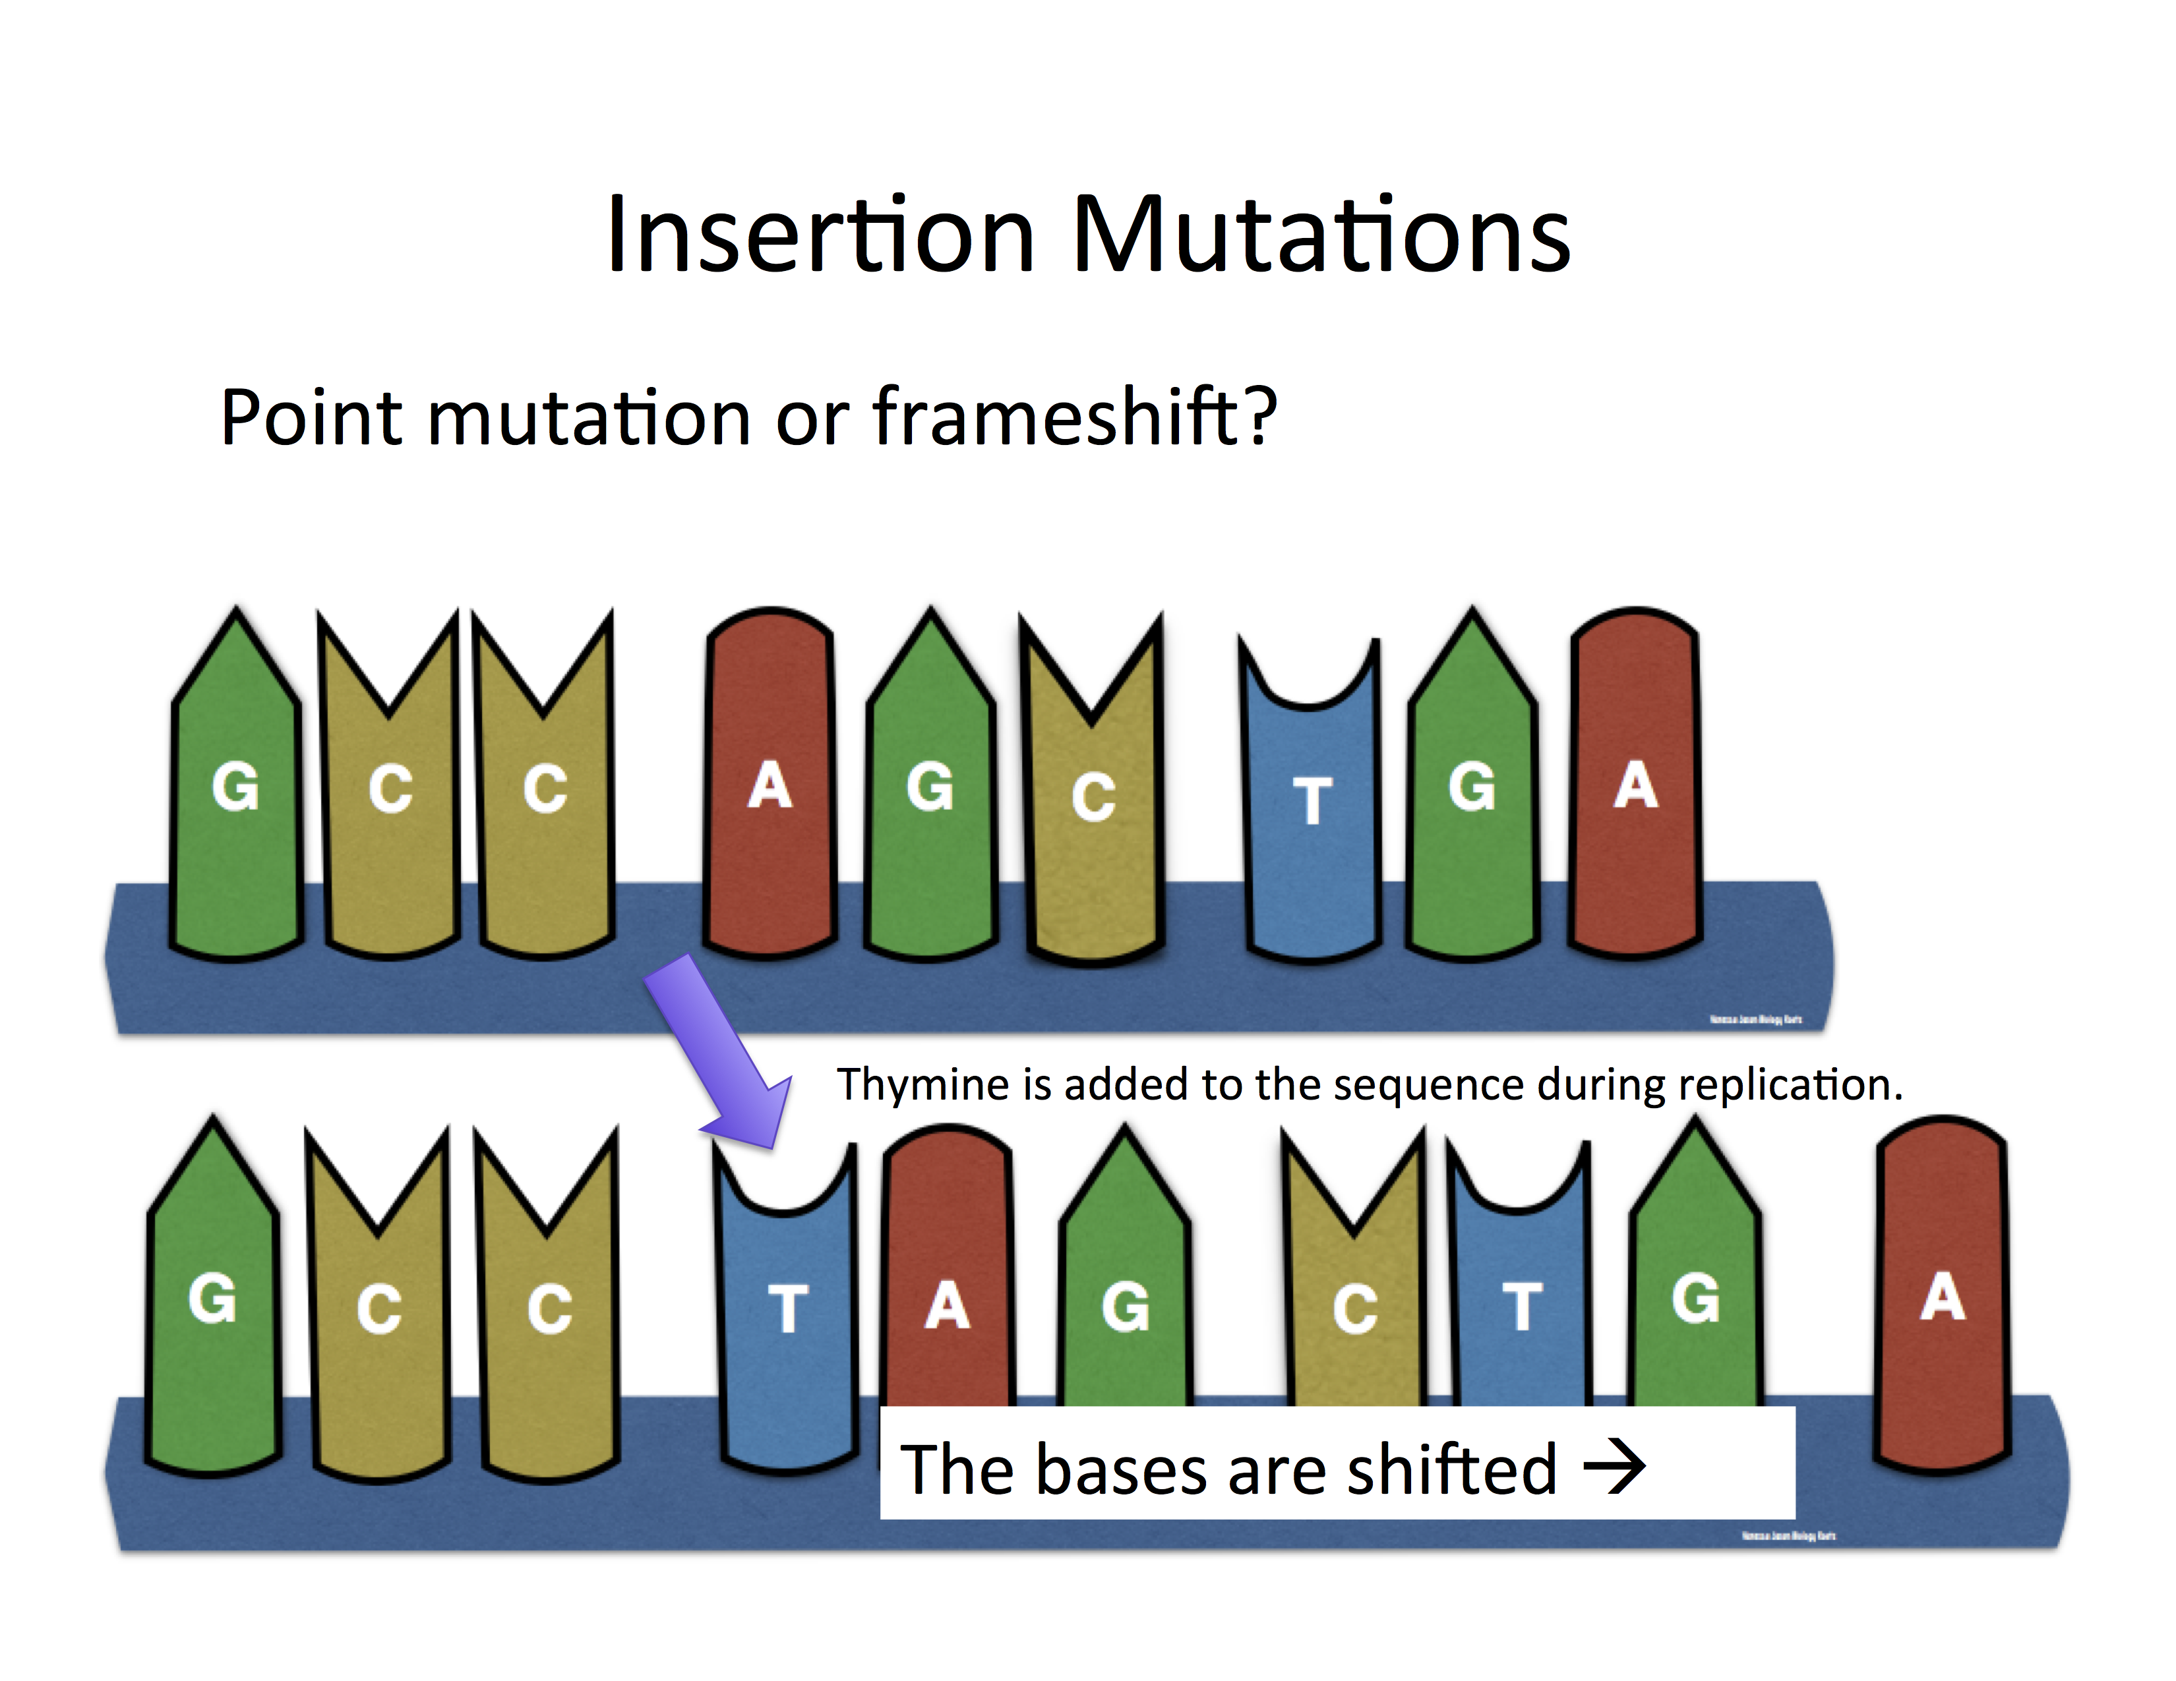

Slide 19
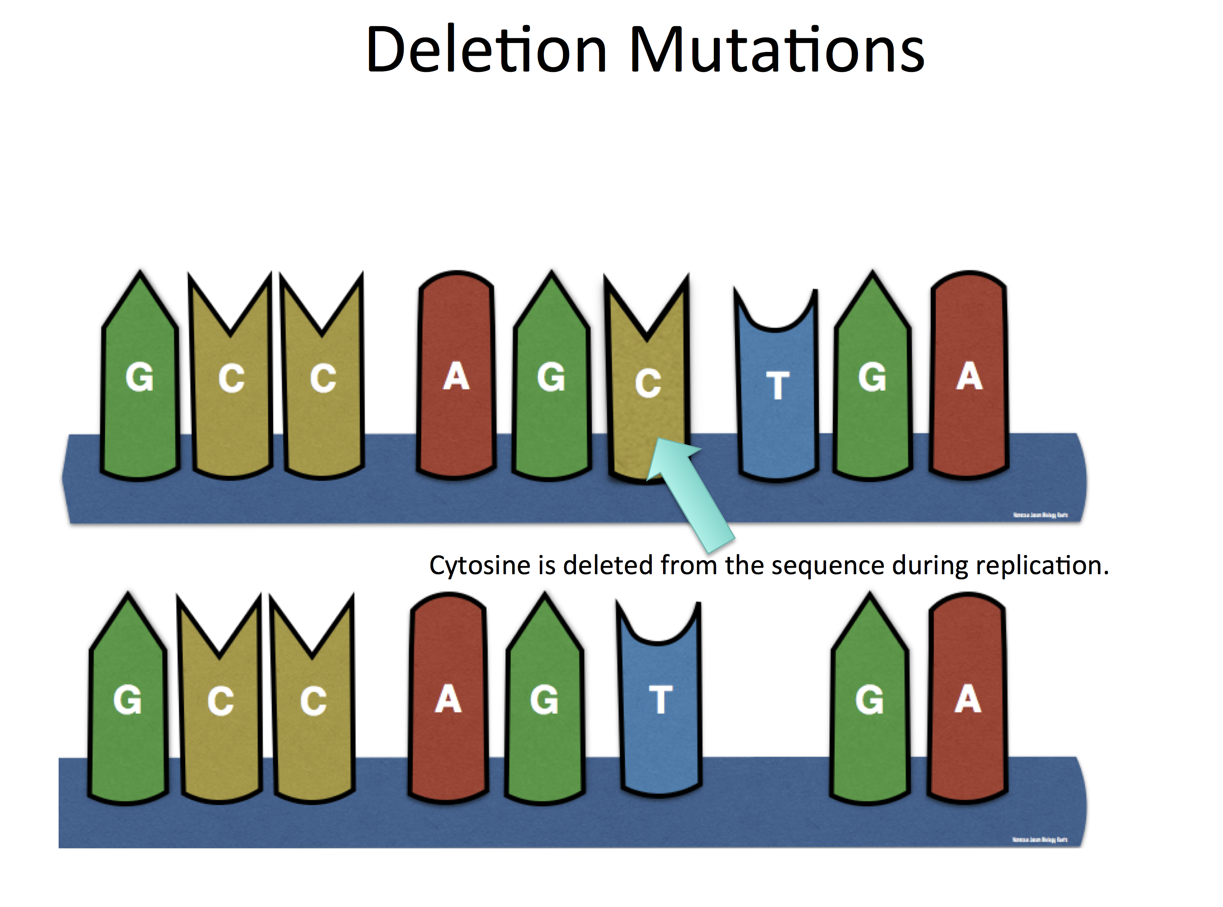
Deletion occurs when a nucleotide is accidentally skipped/deleted from a sequence.

Slide 20
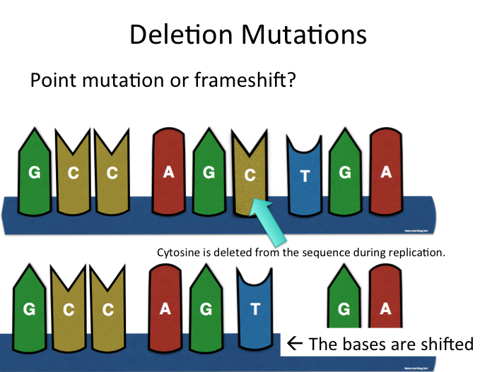

Slide 21
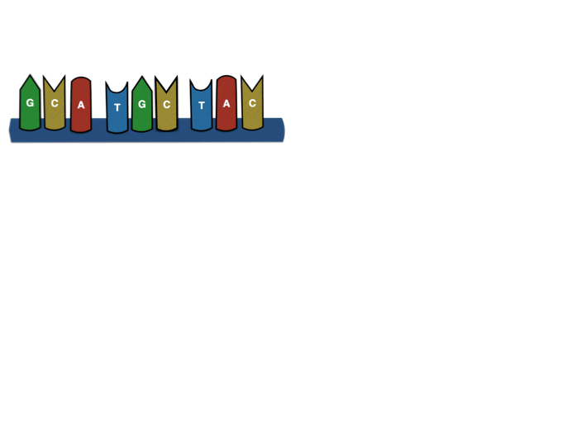
Frameshift Mutations
Before mutation
GCA- TGC- TAC
Amino Acids=
Alanine- Cysteine-Tyrosine

Slide 22
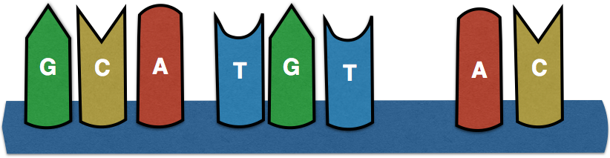

Frameshift Mutations
© Vanessa Jason, Biology Roots
Missense or
Nonsense mutation?
Before mutation
GCA- TGC- TAC Amino Acids= Ala- Cys- Tyr
Deletion Mutation Occurs…
A
After mutation
GCA- TGT- ACA Amino Acids= Ala- Cys- Threonine
© Vanessa Jason, Biology Roots

Slide 23
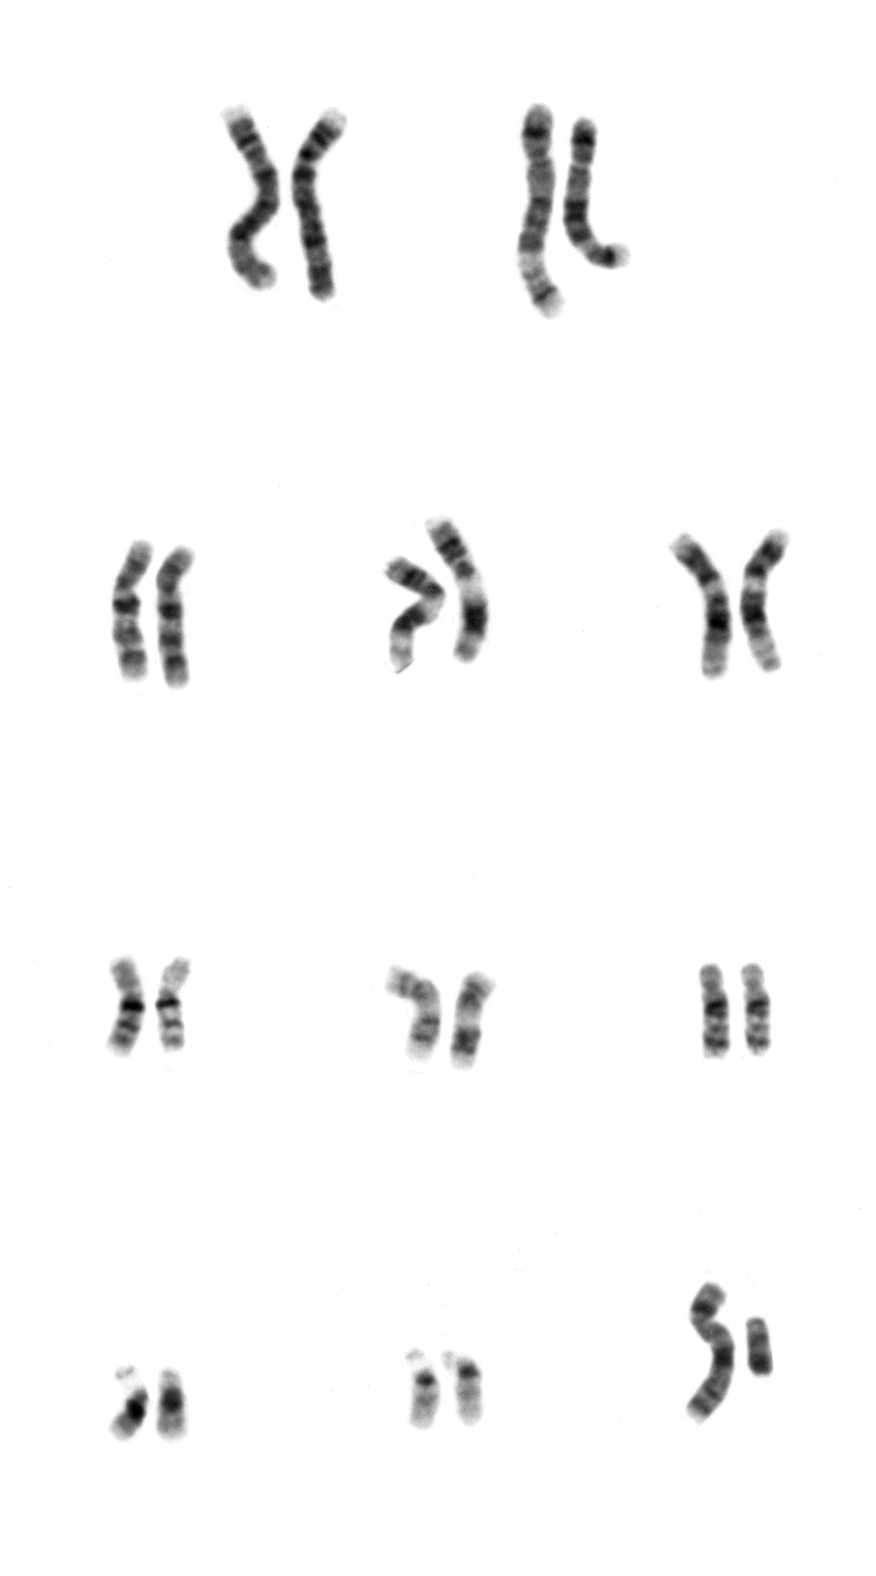
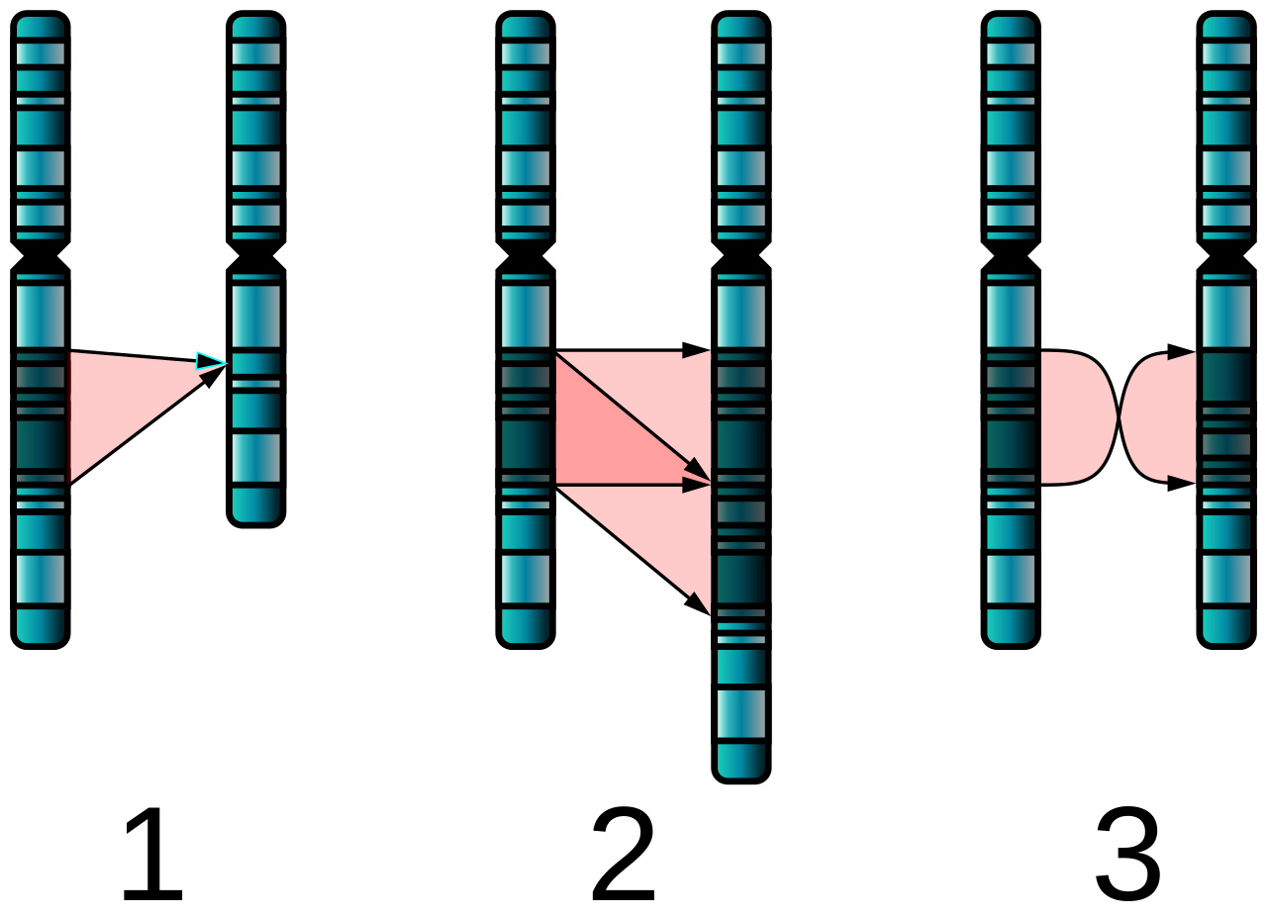
Chromosomal Mutations
A chromosomal mutation changes the number or structure of chromosomes.

Slide 24
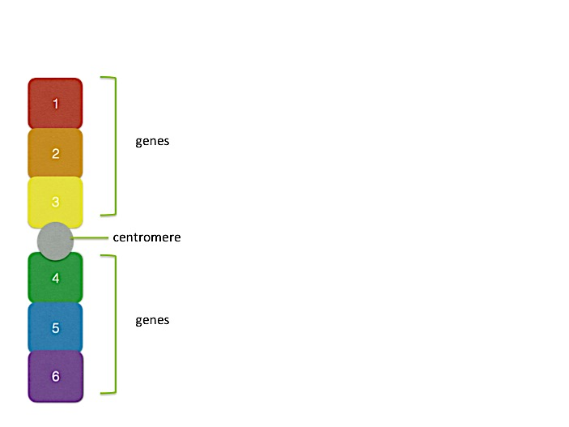
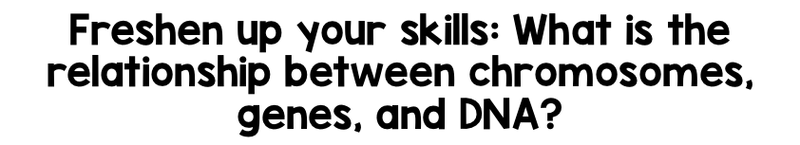
© Vanessa Jason, Biology Roots
Chromosome Structure
Genes are located on the chromosomes. How many genes does the chromosome pictured contain?
genes
centromere
genes
Segments of DNA that code for a particular trait are called genes. Chromosomes are made up of genes (DNA).
© Vanessa Jason, Biology Roots

Slide 25
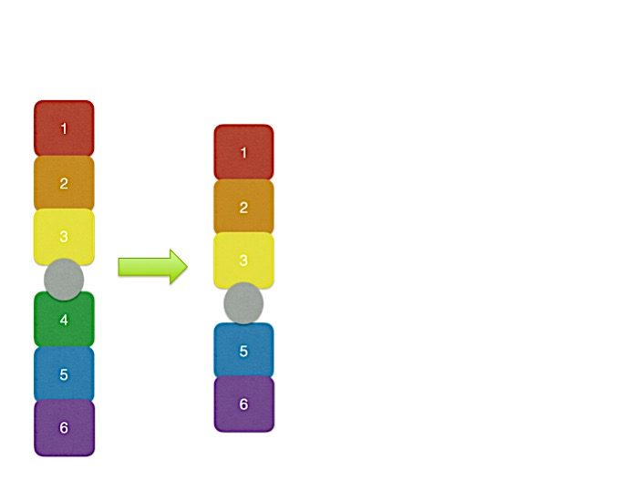
© Vanessa Jason, Biology Roots
Chromosomal Mutation- Deletion
Deletions in chromosomal mutations cause a segment of the chromosome to disappear during replication.
An example of a genetic disorder caused by a chromosomal deletion is Angelman’s syndrome.
© Vanessa Jason, Biology Roots

Slide 26
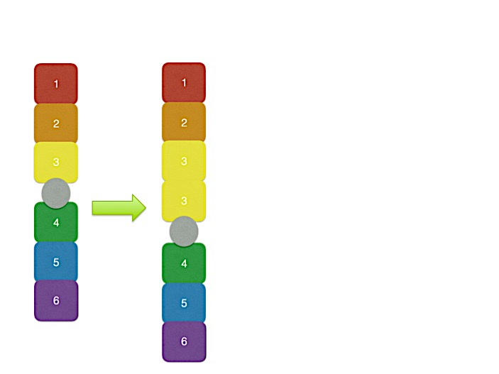
Chromosomal Mutation- Duplication
© Vanessa Jason, Biology Roots
Duplications in chromosomal mutations cause a segment of the chromosome to repeat itself during replication.
This can lead to genetic disorders that include developmental delay.
© Vanessa Jason, Biology Roots

Slide 27
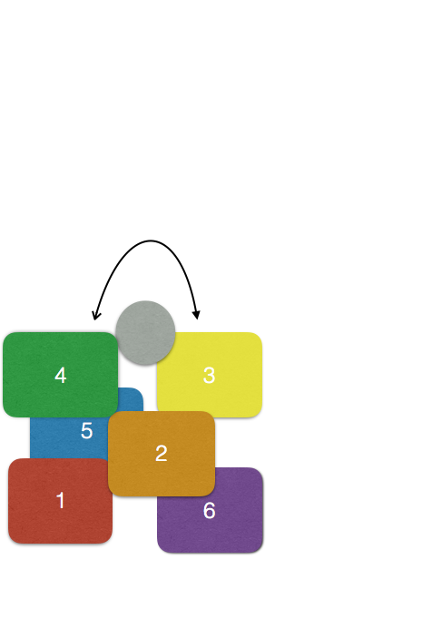
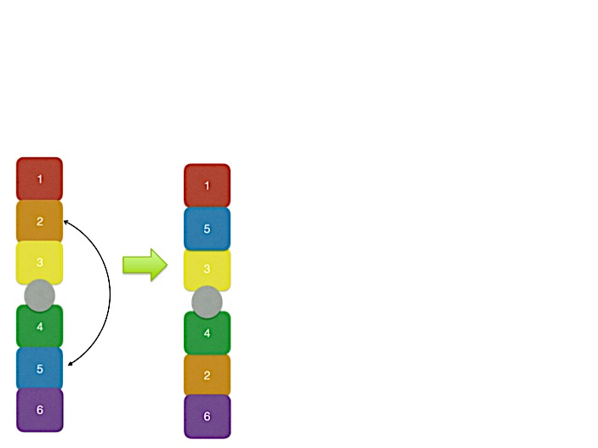
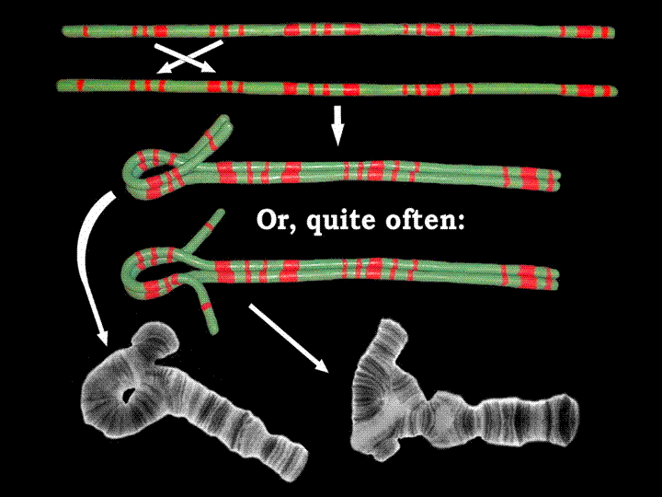
Chromosomal Mutation- Inversion
© Vanessa Jason, Biology Roots
Inversions in chromosomal mutations cause two segments of the chromosome to swap places.
Individuals can have inversion mutations and have no signs or symptoms.
© Vanessa Jason, Biology Roots

Slide 28
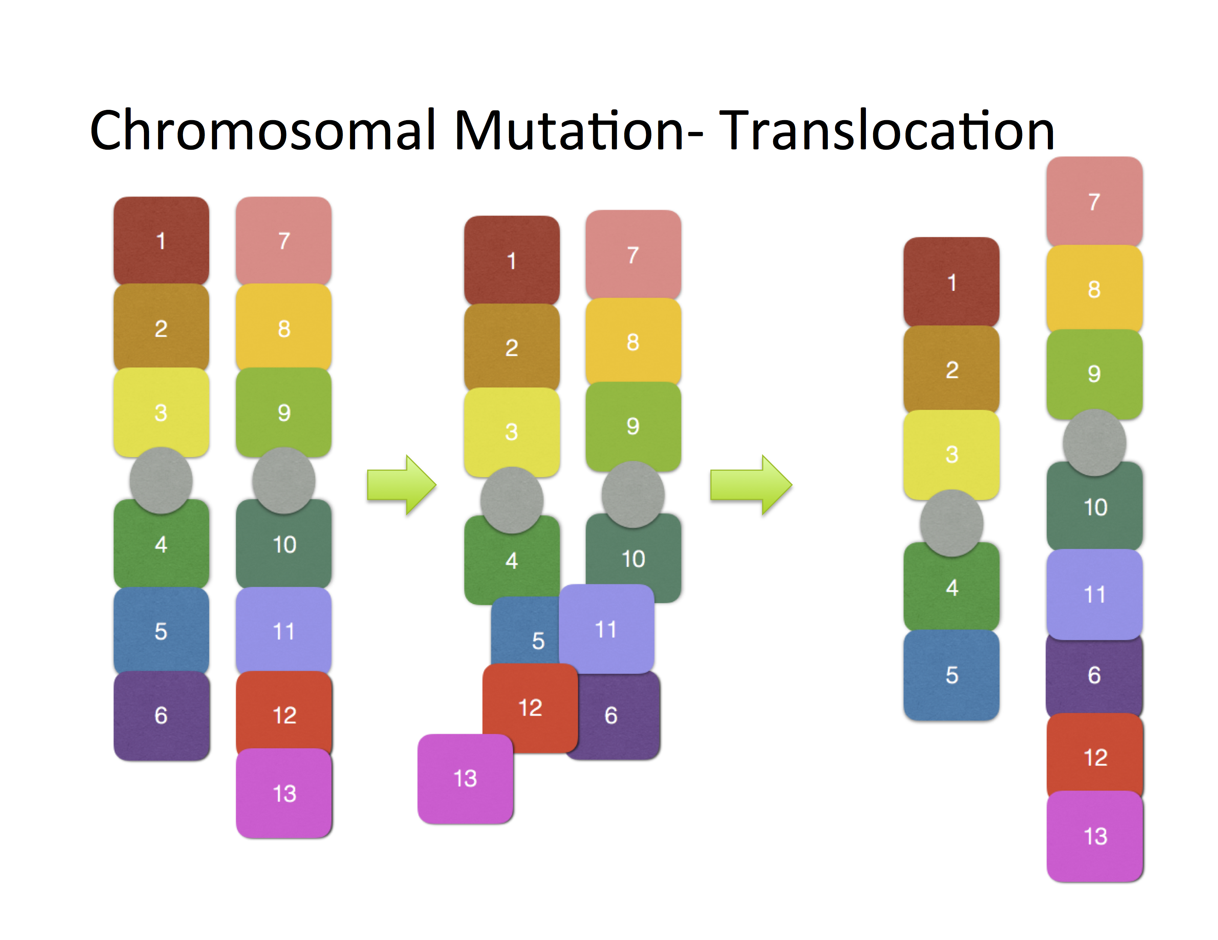

Slide 29
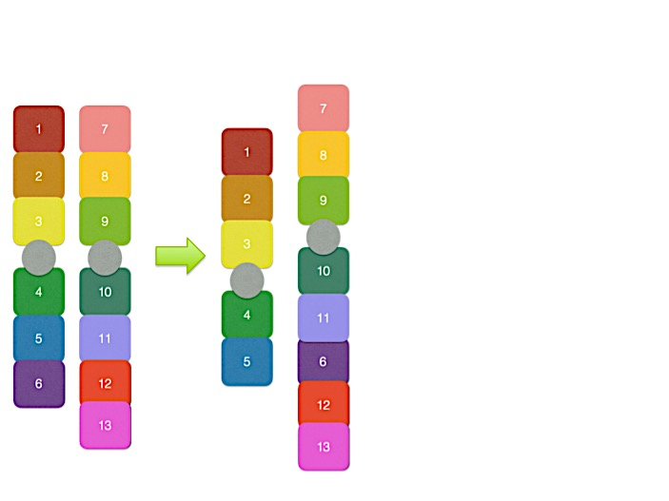
Chromosomal Mutation- Translocation
Translocation occurs when part of one chromosome breaks off and attaches to another nonhomologous chromosome.
Often times, they will swap segments so that two translocations occur at the same time.

Slide 30
How Mutations Affect Individuals
If you experience mutations in your lifetime, you will not change!
Your DNA is replicating constantly- and there are likely errors, but you will not suddenly mutate in response to this.
If mutated DNA is present in egg or sperm cells, these mutations can be passed on to offspring.
Remember… not all mutations are trouble!

Slide 31
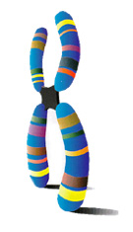
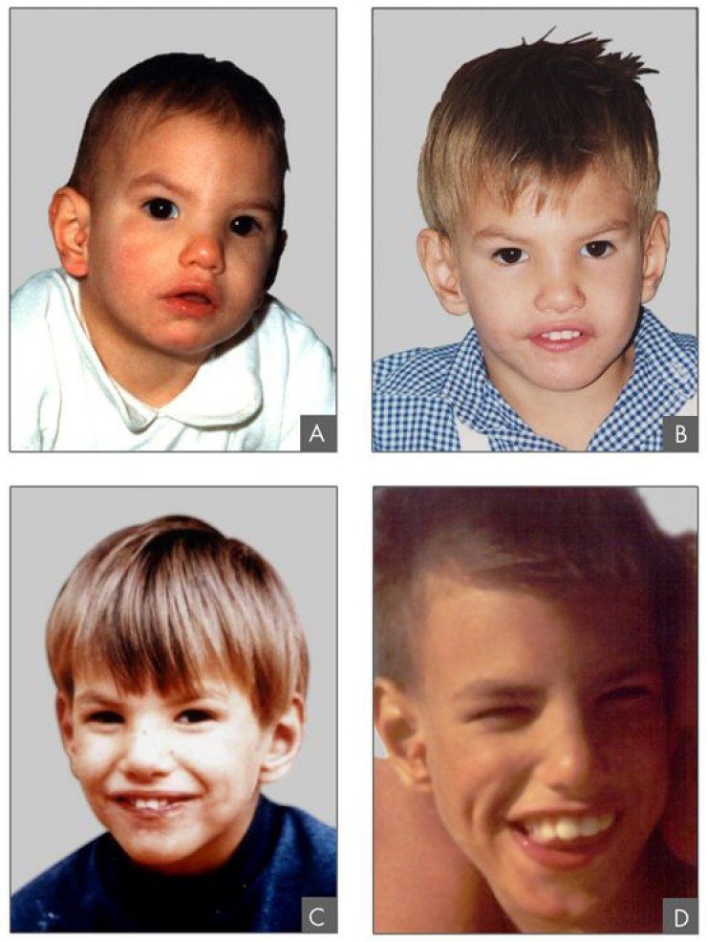
Examples-
Diseases caused by mutations
© Vanessa Jason, Biology Roots
Tay-Sach’s Disease- caused by a frameshift mutation- affects fewer than 20,000 individuals. Causes degeneration of neurons (brain and spinal cord).
Cri du Chat syndrome-
Chromosomal mutation (deletion) that causes facial deformities, intellectual disability, slow growth.
© Vanessa Jason, Biology Roots

Slide 32

Checkpoint
What is the difference between a gene mutation and a chromosomal mutation?
What is the difference between a point mutation and a frameshift mutation?
Name 3 types of gene mutations.
Name 4 types of chromosomal mutations.
How are mutations passed to offspring?

