Slide 1
Non-Mendelian Genetics

Slide 2
Mendelian Genetics: Dominant & Recessive Review
One allele is DOMINANT over the other and the dominant allele will totally mask the recessive allele
genotype: PP
genotype: pp
genotype: Pp
phenotype: purple
phenotype: white
phenotype: purple

Slide 3
Review Problem: Dominant & Recessive
In pea plants, purple flowers (P) are dominant over white flowers (p). Show the cross between two heterozygous plants.
GENOTYPES:
- %
- ratio
PHENOTYPES:
- %
- ratio

Slide 4
It’s not always Dominant/Recessive!
Non-Mendelian Inheritance Patterns
Incomplete Dominance
Codominance
Multiple Alleles
Polygenic Traits
Sex-Linked Traits

Slide 5
Incomplete Dominance
a new phenotype appears in the heterozygous condition as a BLEND of the dominant and recessive phenotypes. Ex - Dominant Red (RR) + Recessive White (rr) = Hybrid Pink (Rr)
RR = red
rr = white
Rr = pink

Slide 6
Problem: Incomplete Dominance
Show the cross between a red and a white flower.
GENOTYPES:
- %
- ratio
PHENOTYPES:
- %
- ratio

Slide 7
Problem: Incomplete Dominance
Show the cross between a pink and a white flower.
GENOTYPES:
- %
- ratio
PHENOTYPES:
- %
- ratio

Slide 8
Codominance
in the heterozygous condition, both alleles are expressed equally with NO blending! Represented by using two DIFFERENT capital letters.
Example - Sickle Cell Anemia: All Normal Cells (NN) + All sickled cells (SS) = half normal/half sickle carrier (NS)
NN = normal cells
SS = sickle cells
NS = some of each
sick

Slide 9
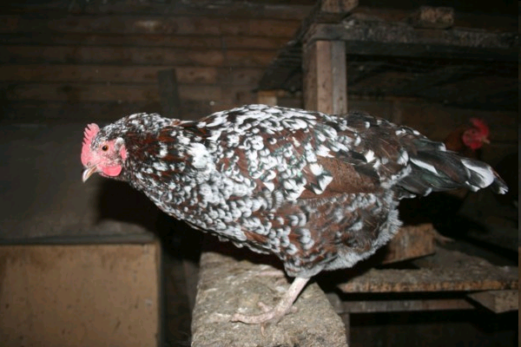
Codominance Example: Checkered Chickens
BB = all black feathers
WW = all white feathers
BW = both black & white feathers (speckled)
Notice –
NO GRAY!
NO BLEND!
Each feather is
either black or white

Slide 10
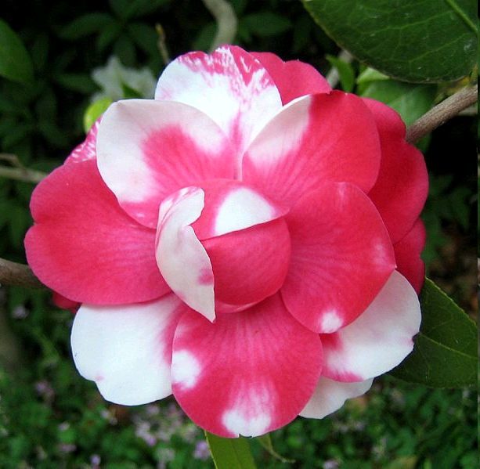
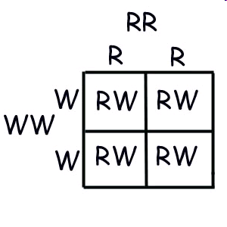
Codominance Example: Rhodedendron
R = allele for red flowers
W = allele for white flowers
Cross a homozygous red flower with a homozygous white flower.

Slide 11
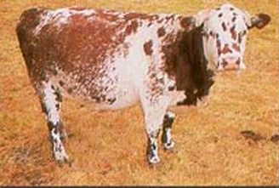
Codominance Example: Roan cattle
cattle can be
red (RR – all red hairs) white (WW – all white hairs) roan (RW – red and white hairs together)

Slide 12
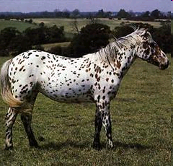
Problem: Codominance in Appaloosa Horses
Gray horses (GG) are codominant to white horses (WW). The heterozygous horse (GW) is an Appaloosa (a white horse with gray spots).
Cross a white horse with an appaloosa horse. Give the genotype and phenotype ratio and percent.

Slide 13
Problem: Codominance in Sickle Cell
Show the cross between an individual with sickle-cell anemia and another who is a carrier but not sick.
GENOTYPES:
- %
- ratio
PHENOTYPES:
- %
- ratio

Slide 14
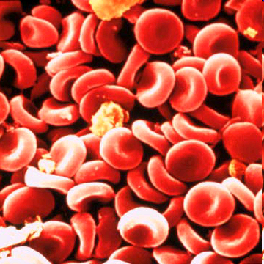
Multiple Alleles
Sometimes there are more than two alleles present in the gene pool for a gene. Ex – blood type consists of two dominant and one recessive allele in humans
Allele A (IA) and
B (IB) are
dominant over
Allele O (i). (NOTE: You still only
get TWO alleles!!!
One from mom and one
from dad)

Slide 15
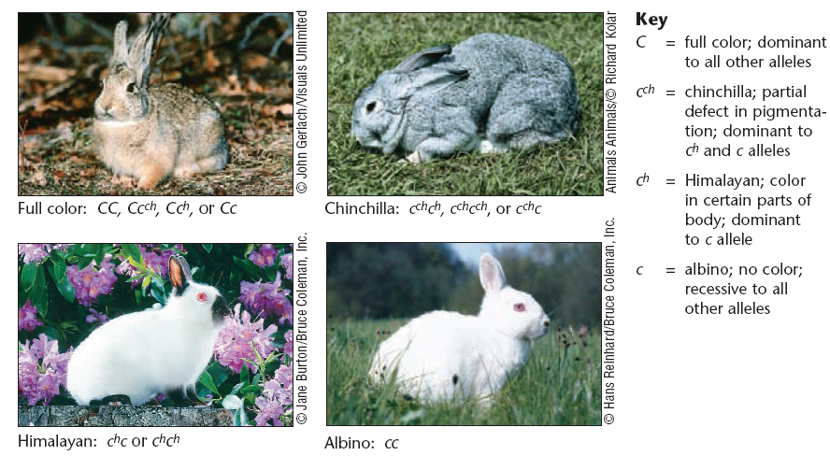
Multiple Alleles: Rabbit Fur Colors
Fur colors (determined by 4 alleles): full color (C), chinchilla (cch), Himalayan (ch), albino (c)

Slide 16
Multiple Alleles: Blood Types (A, B, AB, O)
Rules for Blood Types: (geno = pheno)
A and B are co-dominant (Both show)
I^{A}I^{A} = type A
I^{B}I^{B} = type B
I^{A}I^{B} = type AB
A and B are both dominant over O (Regular dom/rec)
I^{A}i = type A
I^{B}i = type B
ii = type O

Slide 17
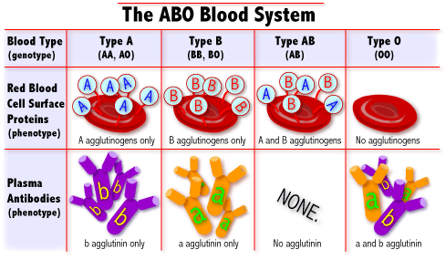
Multiple Alleles: Blood Types (A, B, AB, O)

Slide 18
Phenotype | Possible Genotype(s) | Allele (antigen) on RBC surface | Can Donate Blood To | Can Receive Blood From
A | I^{A}i I^{A}I^{A} | A | A, AB | A, O
B | I^{B}i I^{B}I^{B} | B | B, AB | B, O
AB | I^{A}I^{B} | AB | AB | A, B, AB, O
O | ii | O | A, B, AB, O | O

Slide 19
Problem: Multiple Alleles
Show the cross between a mother who has type O blood and a father who has type AB blood.
GENOTYPES:
- list
PHENOTYPES:
- list

Slide 20
Problem: Multiple Alleles
Show the cross between a mother who is heterozygous for type B blood and a father who is heterozygous for type A blood.
GENOTYPES:
list
PHENOTYPES:
list

Slide 21
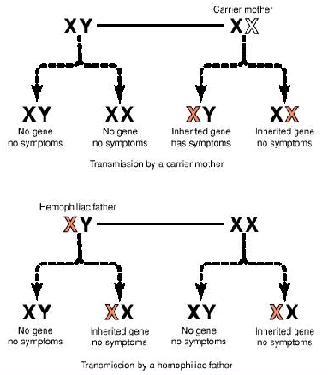
Sex-Linked Traits
Non-gender related genes that are attached to the X chromosome, but not found on the Y chromosome. (Women have XX so they get two of these genes. Men have XY chromosomes so they only get one copy.)
examples: red-green colorblindness, hemophilia, muscular dystrophy

Slide 22
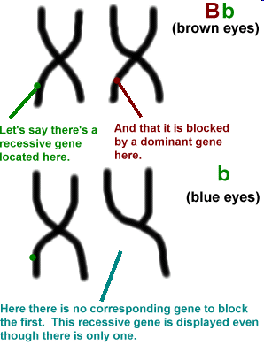
Sex-Linked Traits
These disorders are more common in boys since girls have a “back up” X.
In males, there is no back up to cover a recessive gene. If they get an X with the disorder, they use it. Girls must inherit defective Xs from both parents to have the disorder, otherwise their “back up” will kick in.

Slide 23
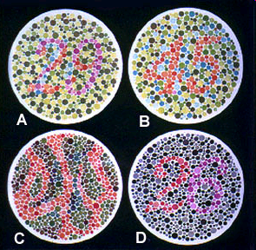

Slide 24
Sex-Linked Traits
A: 29, B: 45, C: --, D: 26
→ Normal vision
A: 70, B: --, C: 5, D: --
→ Red-green color blind
A: 70, B: --, C: 5, D: 6
→ Red color blind
A: 70, B: --, C: 5, D: 2
→ Green color blind

Slide 25
Problem: Sex Linked
Show the cross between a mother whose father was colorblind and a normal vision man
GENOTYPES:
Male %
Female %
PHENOTYPES:
Male %
Female %

Slide 26
Problem: Sex Linked
Show a cross between a carrier mother and a male with hemophilia
GENOTYPES:
Male %
Female %
PHENOTYPES:
Male %
Female %

Slide 27
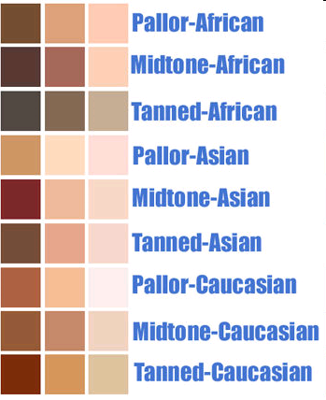
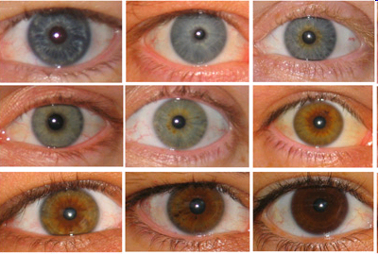
Polygenic Traits
traits produced by more than one pair of genes; results in a variety of phenotypes
example: skin color, eye color, height
(No punnett square)

