Slide 1
Types of Speciation, Evolution & Isolation

Slide 2
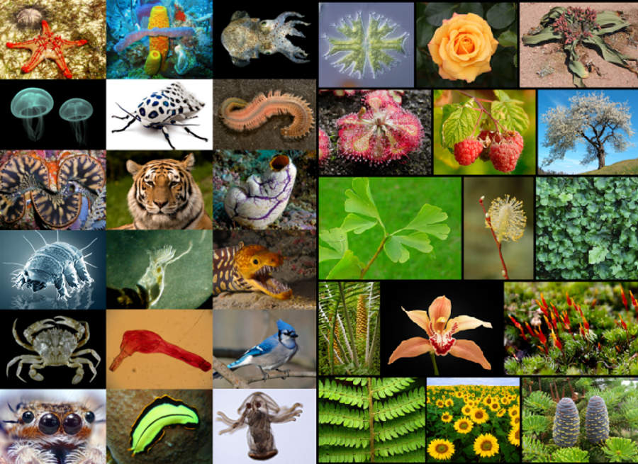
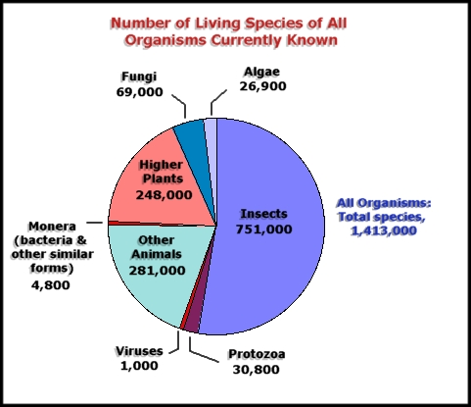
Currently there are 8.7 million species of “EUKARYOTES” -80% are still undiscovered
How did we end up with so many species around the world?

Slide 3
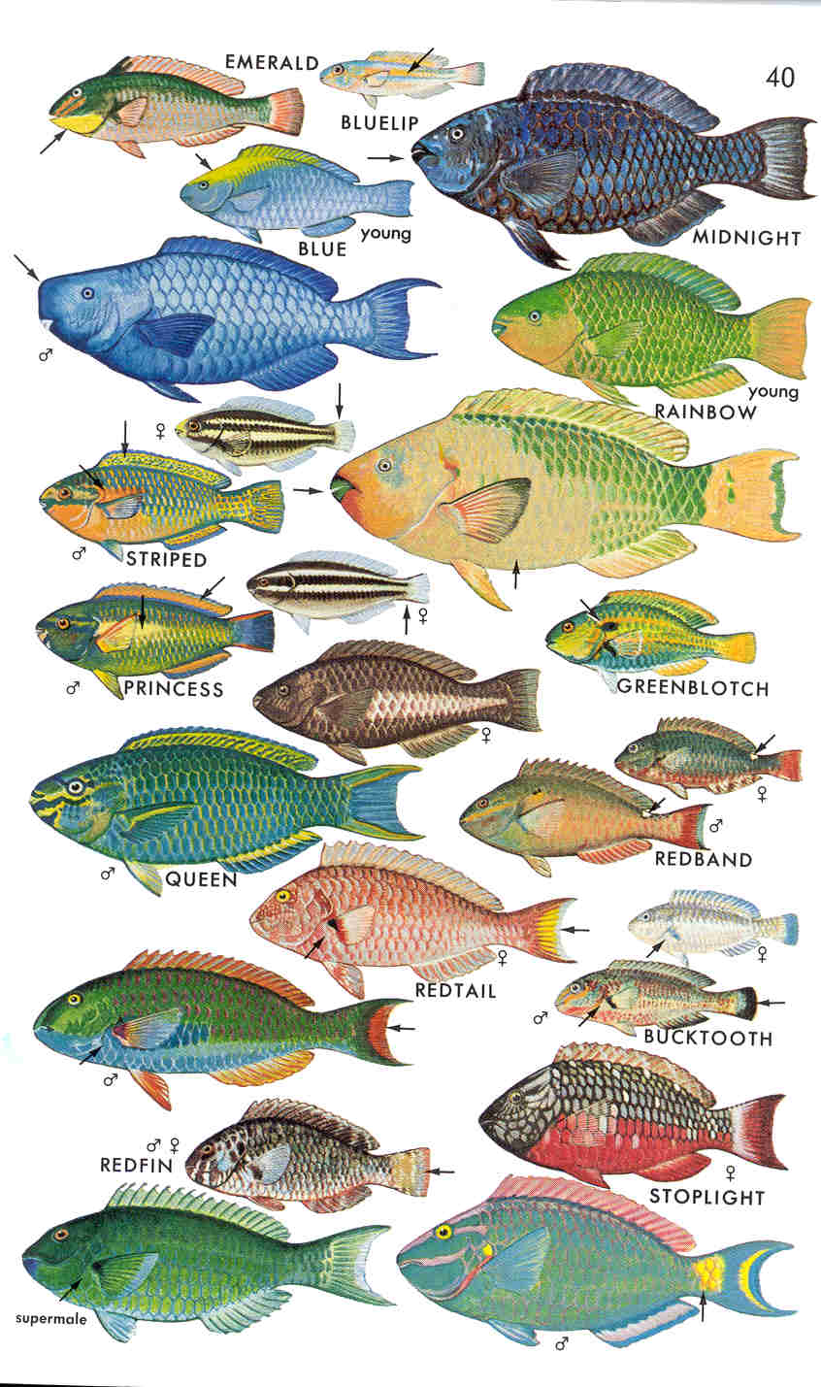
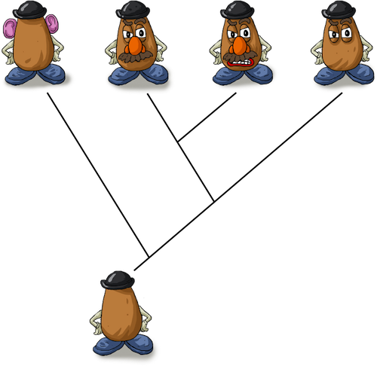
What is speciation?
Speciation:
The formation of new and distinct species in the course of evolution

Slide 4
Types of Speciation
Allopatric Speciation
Definition: new species evolves as a result of geographic isolation

Slide 5
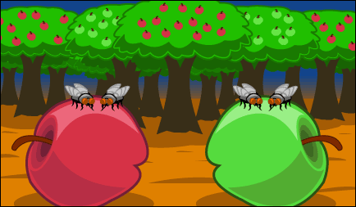
Types of Speciation
Sympatric Speciation
Definition: new species evolves from single ancestor while living in same geographic niche (organism’s “place” in ecosystem)

Slide 6
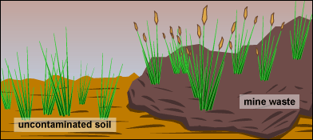
Types of Speciation
Parapatric Speciation
Definition: new species evolves as a result of partial geographic isolation as a result of occupying a new/different niche

Slide 7
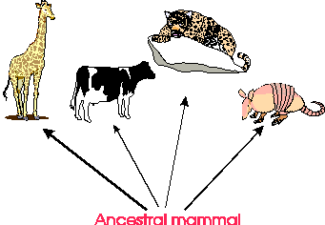
Types of Evolution
Divergent Evolution
Definition: new species evolves from a common ancestor

Slide 8
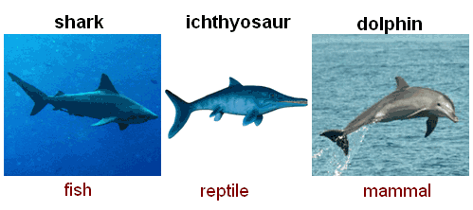
Types of Evolution
Convergent Evolution
Definition: unrelated species become similar as they adapt to similar environments

Slide 9
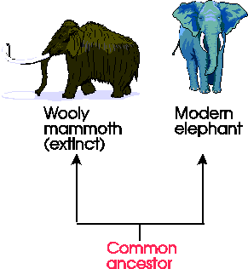
Types of Evolution
Parallel Evolution
Definition: development of a similar trait in related, but distinct, species descending from a common ancestor

Slide 10
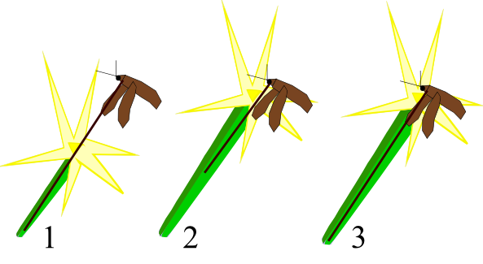
Types of Evolution
Coevolution
Definition: influence of closely associated species on each other in their evolution

Slide 11
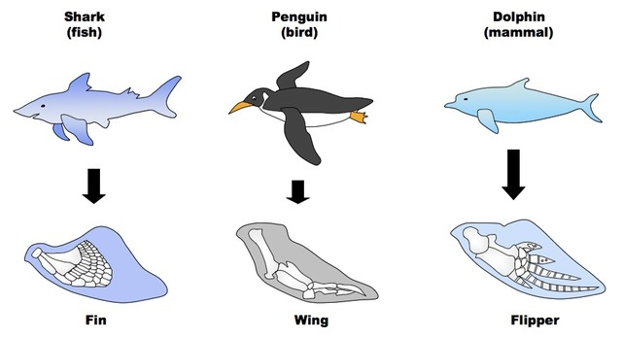
Analogous structures
Definition: structures present in different organisms that have the same function but are structurally different and have different origins

Slide 12
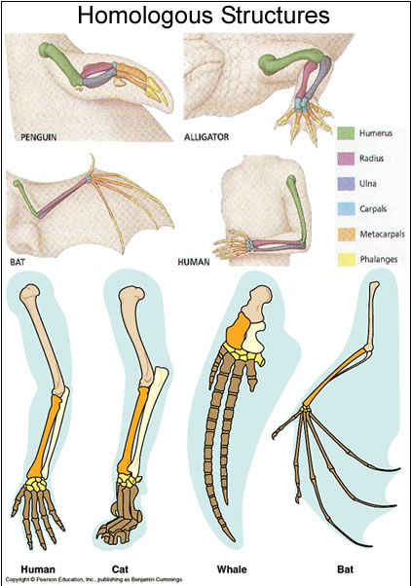
Homologous structures
Definition: structures present in different organisms that have the same underlying structure but may have different functions

Slide 13
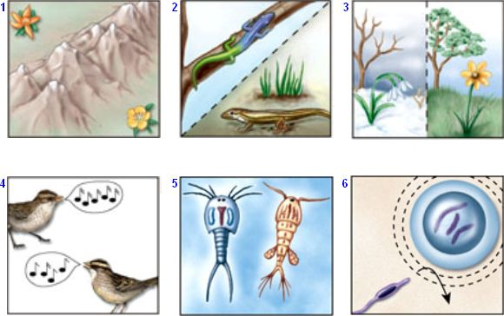
Types of isolation
Prezygotic Isolation
Definition: reproductive isolation preventing a zygote
Example: geographic, behavioral, mechanical

Slide 14
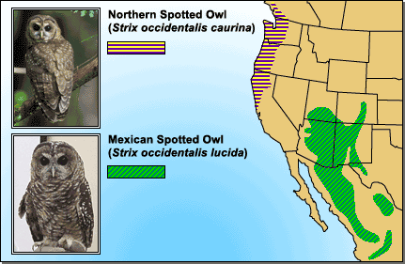
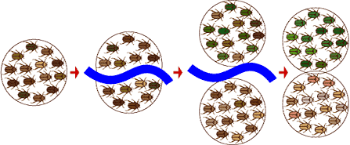
Geographic Isolation
Definition: When a population is divided into two or more smaller populations due to PHYSICAL BARRIERS.
This can occur when rivers change course, mountains rise, continents drift, or organisms migrate.
Example: Northern Spotted Owl and Mexican Spotted Owl

Slide 15
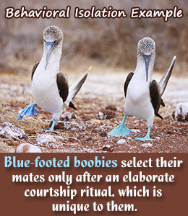
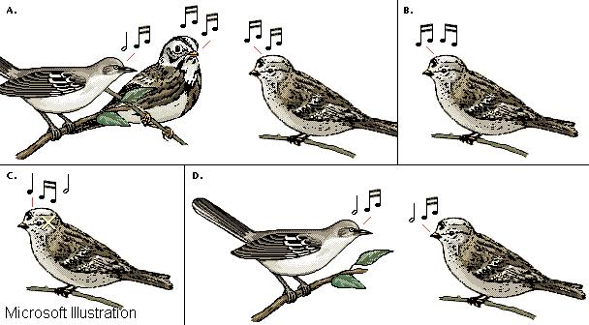
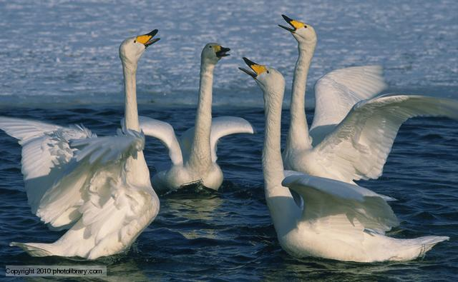
Behavioral Isolation
Defition: Two species do not mate because of differences in courtship behavior.
Example: Blue footed boobies (mating dance), birds (mating song), nocturnal versus diurnal

Slide 16
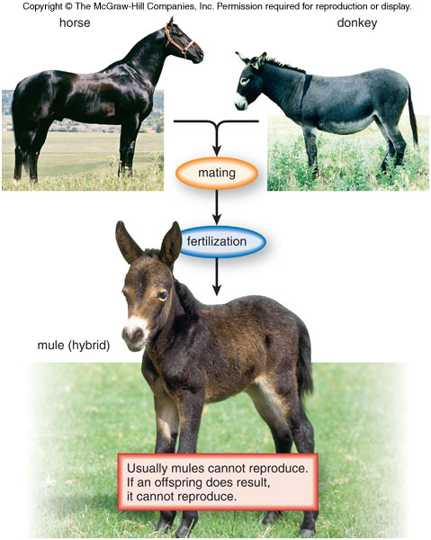
Types of isolation
Postzygotic Isolation
Horse
Donkey
Definition: reproductive isolation that occurs after two species have mated
Example: hybrid mule offspring are infertile
Hybrid = Mule
Can NOT reproduce

Slide 17
What Type of evolution is this?
The kit fox lives in the desert where its coat helps disguise it from its predators. The red fox lives in forests where its red coat blends into its surroundings.
Divergent Evolution

Slide 18
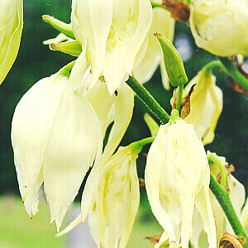
What Type of evolution is this?
Yucca flowers are a certain shape so only that tiny moth can pollinate them. The moths lay their eggs in the yucca flowers and the larvae (caterpillars) live in the developing ovary and eat yucca seeds.
Coevolution

Slide 19
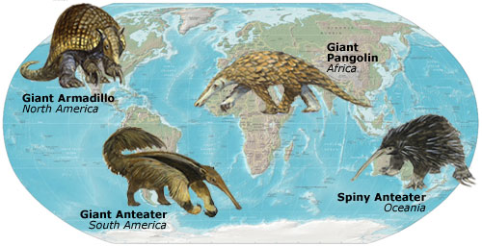
What Type of evolution is this?
There are species, found in Australia, Africa, and America. Though not related, they all evolved the "tools" necessary to subsist on an ant diet: a long, sticky tongue, few teeth, a rugged stomach, and large salivary glands.
Convergent Evolution

Slide 20
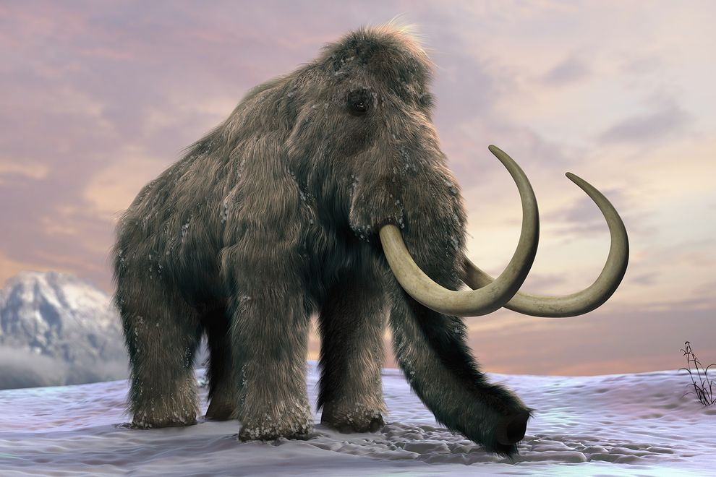
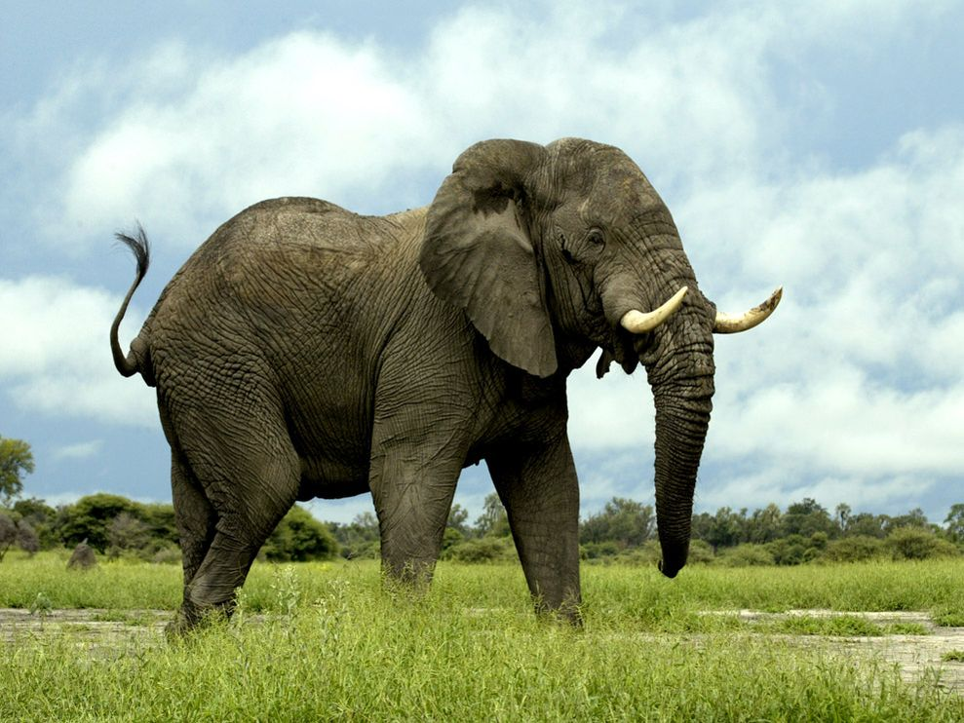
What Type of evolution is this?
The woolly mammoth (extinct) and the modern elephant both share a similar structural appearance of their trunk and tusks. They share a common ancestor and developed similar traits.
Parallel Evolution

Slide 21
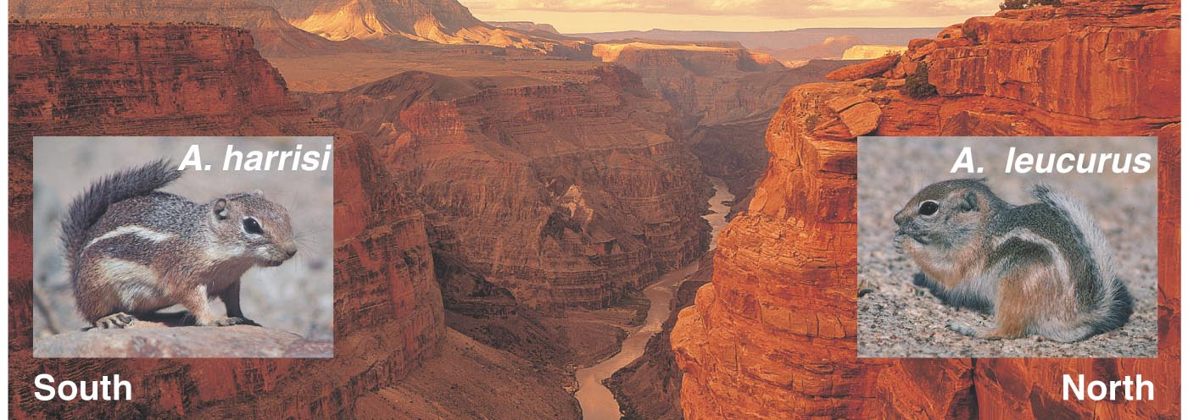
What Type of SPECIATION is this?
When Arizona's Grand Canyon formed, squirrels and other small mammals that had once been part of a single population could no longer contact and reproduce with each other across this new geographic barrier.
Allopatric Speciation

Slide 22
What Type of SPECIATION is this?
Some grass the grow around mines are tolerant of heavy metals in soil. Meanwhile, neighboring grasses don't live in polluted soil, but they occupy a continuous geographic population. The two grasses have evolved different flowering times (niche).
Parapatric Speciation

Slide 23
What Type of SPECIATION is this?
The apple maggot lays its eggs inside an apple, causing it to rot. As the apple falls from the tree, the maggots dig in the ground and emerge as flies later. The original hawthorn species still only lays its eggs in hawthorn apples.
Sympatric Speciation

Slide 24
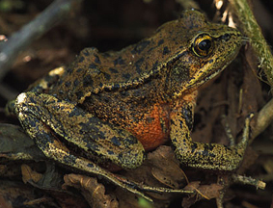
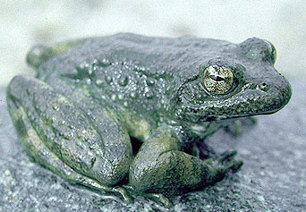
What Type of ISOLATION is this?
The Red-legged Frog (Rana aurora, left) breeding season lasts from January to March.
The closely related Yellow-legged Frog (Rana boylii, right) breeds from late March through May.
Prezygotic Isolation

Slide 25
What Type of ISOLATION is this?
A zygote may form with union of sperm and egg from the two species, but the embryo dies after a few cell divisions. The genetic information from male and female parents is insufficient to produce a viable offspring.
Postzygotic Isolation

Slide 26
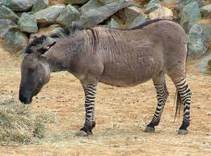
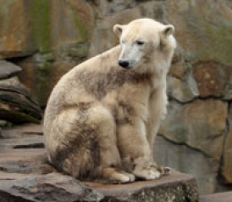
What Type of ISOLATION is this?
Viable hybrid is produced (often physically more vigorous than either parent), but is unable to reproduce (sterile). Ex: zorse, grolar bear
Postzygotic Isolation

Slide 27
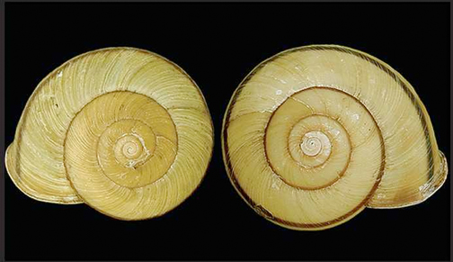
What Type of ISOLATION is this?
In some snail species, the direction of shell coiling is controlled by a single (maternal effect) gene. Snails with left-coiling shells cannot mate with snails having right-coiling shells.
Prezygotic Isolation

Slide 28
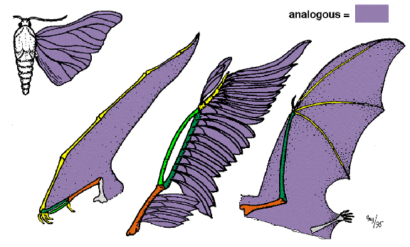
What Type of STRUCTURE is this?
Similar function, different structure, different origin
Analogous Structure

Slide 29
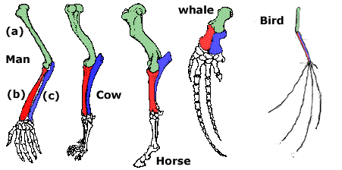
What Type of STRUCTURE is this?
Same underlying structure, different function
Homologous Structure

