Slide 1
Chapter 17: Viruses and Bacteria
Section 1: Viruses

Slide 2
Viruses
The word virus comes from the Latin language
“Poison”
About 100 years ago in what is now Ukraine, an epidemic of tobacco mosaic disease occurred that seriously threatened the tobacco crop
The disease-causing nature of the juice from infected tobacco leaves was discovered by the Russian biologist Dimitri Iwanowski
A few years later, the Dutch scientist Martinus Beijerinck determined that tiny particles in the juice caused the disease
Viruses

Slide 3
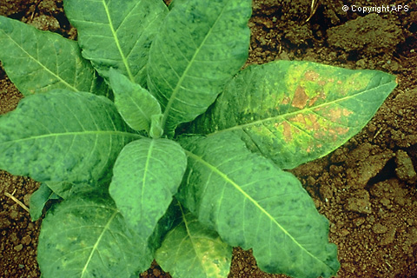
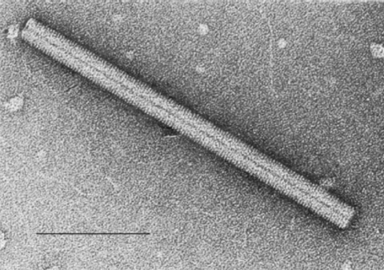
Tobacco mosaic virus (TMV) causes the leaves of tobacco plants to develop a pattern of spots called a mosaic.

Slide 4
What is a Virus?
Viruses have distinct structures that are complex and fascinating
A virus is a noncellular particle made up of genetic material and protein that can invade living cells

Slide 5
Structure of a Virus
A typical virus is composed of a core of nucleic acid surrounded by a protein coat called a capsid
The capsid protects the nucleic acid core
The nucleic acid core is either DNA or RNA but never both

Slide 6
Structure of a Virus
A more complex structure occurs in certain viruses known as bacteriophages
Viruses that invade bacteria
A bacteriophage has a head region, composed of a capsid (protein coat), a nucleic acid core, and a tail
Bacteriophages are interesting and relatively easy to study because their hosts multiply quickly
Viruses come in a variety of shapes and sizes

Slide 7
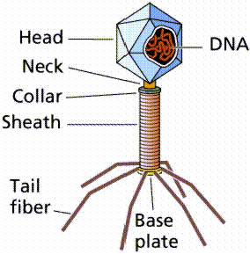
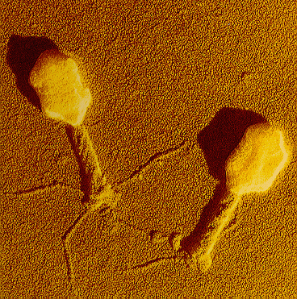
A bacteriophage is a virus that infects bacteria. Compare the structures shown in the diagram of the bacteriophage to those in an actual bacteriophage.

Slide 8
Specificity of a Virus
Usually, specific viruses will infect specific organisms
There are some viruses that will infect only humans
Others may infect more than one animal group, such as rabies

Slide 9
Life Cycle of a Lytic Virus
In order to reproduce, viruses must invade, or infect, a living host cell
However, not all viruses invade living cells in exactly the same way
When T4 bacteriophages invade living cells, they cause cells to lyse, or burst
Lytic viruses

Slide 10
Infection
A virus is activated by chance contact with the right kind of host cell
In the case of the T4, molecules on its tail fibers attach to the surface of a bacterium
The virus then injects its DNA into the cell
In most cases, the compete virus particle itself never enters the cell

Slide 11
Growth
Soon after entering the host cell, the DNA of the virus goes into action
In most cases, the host cell cannot tell the difference between its own DNA and the DNA of the virus
Consequently, the very same enzyme RNA polymerase that makes mRNA from the cell’s own DNA begins to make mRNA from the genes of the virus
Shuts down and takes over the infected host cell

Slide 12
Replication
As the virus takes over, it uses the materials of the host cell to make thousands of copies of its own protein coat and DNA
Soon the host cell becomes filled with hundreds of viral DNA molecules
During the final stage of reproduction, the DNA molecules serve as the starting points around which new virus particles are assembled
Before long, the infected cell lyses and releases hundreds of virus particles that may now infect other cells
Because the host cell is lysed and destroyed, this process is called a lytic infection

Slide 13
Lysogenic Infection
Another way in which a virus infects a cell is known as a lysogenic infection
In a lysogenic infection, the virus does not reproduce and lyse its host cell
Instead, the DNA of the virus enters the cell and is inserted into the DNA of the host cell
Once inserted into the host cell’s DNA, the viral DNA is known as a prophage
The prophage may remain part of the DNA of the host cell for many generations

Slide 14
Prophage Activity
The presence of the prophage can block the entry of other viruses into the cell and may even add useful DNA to the host cell’s DNA
A virus may not stay in the prophage form indefinitely
Eventually, the DNA of the prophage will become active, remove itself from the DNA of the host cell, and direct the synthesis of new virus particles
A series of genes in the prophage itself maintains the lysogenic state
Factors such as sudden changes in temperature and availability of nutrients can turn on these genes and activate the virus

Slide 15
Retroviruses
One important class of viruses are the retroviruses
Retroviruses contain RNA as their genetic information
When retroviruses infect a cell, they produce a DNA copy of their RNA genes
This DNA, much like a prophage, is inserted into the DNA of the host cell
Retroviruses received their name from the fact that their genetic information is copied backward
From RNA to DNA
Retroviruses are responsible for some types of cancer in animals and humans
One type of retrovirus produces a disease called AIDS

Slide 16
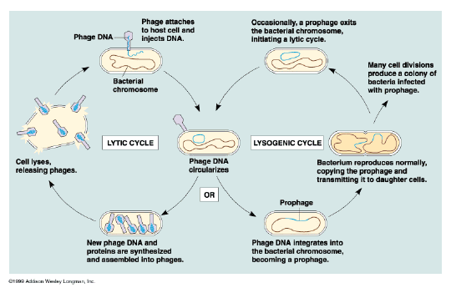

Slide 17
Viruses and Living Cells
Viruses must infect living cells in order to carry out their functions of growth and reproduction
They also depend upon their hosts for respiration, nutrition, and all of the other functions that occur in living things
Viruses are parasites
Depends entirely upon another living organism for its existence in such a way that it harms that organism

Slide 18
Viruses and Living Cells
Because it is possible to study the genes that viruses bring into cells when they infect them, viruses have been extremely valuable in genetic research
Some viruses are now being used in gene therapy
It is possible that modified viruses may one day be routine medical tools

Slide 19
Origin of Viruses
Although viruses are smaller and simpler than the smallest cells, they could not have been much like the first living things
Viruses are completely dependent upon living cells for growth and reproduction, and they cannot live outside their host cells
It seems more likely that viruses developed after living cells
In fact, the first viruses may have evolved from the genetic material of living cells and have continued to evolve, along with the cells they infect, over billions of years

Slide 20
Diseases Caused by Viruses and Bacteria
Only a small number of viruses and bacteria are capable of producing disease in humans
Despite their small numbers, these pathogens, or disease-producing agents, are responsible for much human suffering

Slide 21
Viruses and Disease
Viruses are the cause of such human disease as smallpox, polio, measles, AIDS, mumps, influenza, yellow fever, rabies, and the common cold
In most viral infections, viruses attack cells of the body in the same way that the T4 bacteriophage attacks E. coli
As the virus reproduces, it destroys the cell that it infects, causing the symptoms of the disease
Vaccines provide immunity to the disease

Slide 22
Interferons
One possible approach in the treatment of viral diseases is the use of substances called interferons
Small proteins that are produced by the body’s cells when the cells are infected by a virus
Make it more difficult for the viruses to infect other cells

Slide 23
Cancer
Certain viruses cause cancer in animals
Oncogenic viruses
Rous sarcoma virus
Discovered by Peyton Rous
Causes cancer in chickens and other domestic fowl
Adds certain genes to the infected cell that seem to turn it into a cancer cell

Slide 24
Bacteria and Disease
There are only a few bacteria that produce disease
Some of the diseases caused by pathogenic bacteria include diphtheria, tuberculosis, typhoid fever, tetanus, Hansen disease, syphilis, cholera, and bubonic plague
Can damage the cells and tissues of the infected organism directly
May release toxins that travel throughout the body

Slide 25
Bacteria and Disease
If an infection does occur, however, there are many more effective measures to fight the infection if it is bacterial than if it is viral
Antibiotics
Attack and destroy bacteria

Slide 26
Controlling Bacteria
Although most bacteria are harmless and many are beneficial, the risks of bacterial infection are great enough to warrant efforts to control bacterial growth

